Slide 1
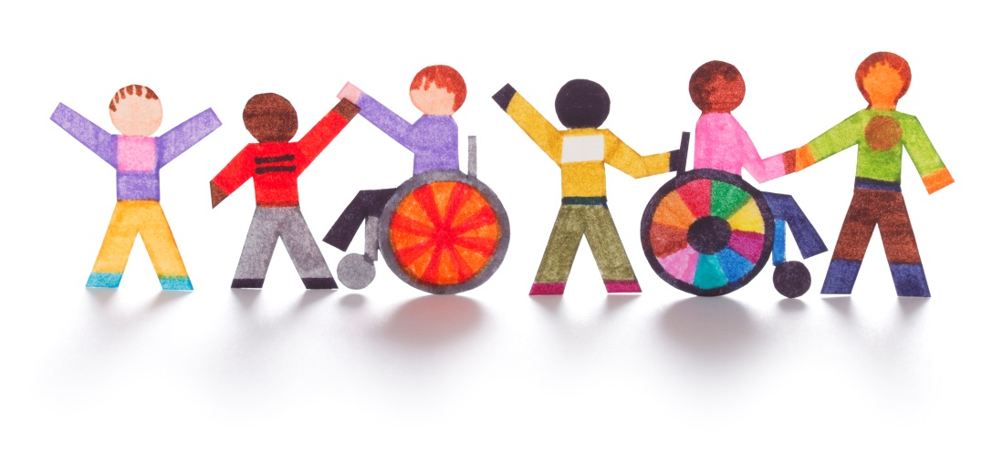


Supporting Friendship
A Workshop for parents, by parents
Created by Ingrid Flory & Brittany Antuna
as a part of
Creating Our Common Wealth
an initiative of the
Department of Developmental Services
in partnership with:
Widening the Circle
Notes:
Challenging Topic to discuss.

Slide 2
“I would rather walk with a friend in the dark than alone in the light.”
– Helen Keller
Notes:
“Love this quote and has become a mantra”

Slide 3
Thinking About friendship
Think about a good friend. On the paper provided, write down:
Their Name
Then share with the group:
Where You Met
How Long You Have Been Friends
One Quality or Characteristic That You Love About Your Friend
Notes:
Hand out index cards and markers. “Think about a good friend.”
10-15 minutes
On Dry Erase/Easel make: 1 collumn for each: Where, How Long, Why (quality or characteristic you love about friend)
Write down name of friend on index card – make it big and bold because we’re honoring them today.
“Who wants to tell me about their friend” have another volunteer tape to wall while person answers the 3 questions.
Typically 8-10 volunteers. Then collect all names and put on wall.
“Let’s discuss what we observe on the chart”: What is friendship and why is it important
Where we meet and make friends tends to be places where we go regularly (school, neighborhood, etc.)
What brings us together are shared interests or shared experiences (i.e. Family Leadership Series) – what are places where we go with shared interests
Different phases of lives, you’ll meet and make new and/or different friends
Discuss why: does things with me, holds me accountable/tough love, listens, compassionate, etc.

Slide 4
Friendships Benefit everyone
Being HAPPIER!
Being HEALTHIER!
Being SAFER!
Reducing isolation and loneliness.
Increasing self-confidence.
Being exposed to more perspectives.
Being part of a larger circle that may lead to jobs, intimate relationships, and other opportunities.
“GOOD RELATIONSHIPS KEEP US HAPPIER AND HEALTHIER. PERIOD.”
– Robert Walinger, Director of Harvard Study of Adult Development
Notes:
If you didn’t value friendships, you wouldn’t be here tonight. So we are just going to take a few minutes to reinforce why this is so important, because you may need to remind others when you return home.
Based on the Harvard Study of Adult Development, which may be the longest study of adult life ever done, and has tracked the lives of 724 men for 75 years. The clearest message from the study according to Director Robert Walinger is that “good relationships keep us happier and healthier. Period.”
In another study of women with cancer called the U.S. Nurse’s Study, having a good friend (not a spouse) had statistic significantly improvement in regaining heath. They found that these women with breast cancer were 4 times more likely to survive if they had friends.
Loneliness can shorten your life the same amount as smoking or being morbidly obese.
The most important thing in the studies is the QUALITY not QUANTITY that make the difference in quality of life.

Slide 5
Friendships Benefit Our Families
Natural opportunities for respite.
Opportunities for other family members to connect. Disability often isolates whole families.
Peace of mind knowing that their family member truly BELONGS.
Natural opportunities for your child to increase their social skills.
Notes:
It can take a good deal of time and energy for us to support our kids in making friends, but it is worth it in the end! Keep the goal in mind so you don’t give up!

Slide 6
Friendships benefit OUR Communities
Enhancing perceptions about people with disabilities
Creating more inclusive attitudes and opportunities in the community
Teaching community members how to be friends with people who have differences
Notes:
Unfortunately, we as parents are in the position of constantly teaching the greater community about how to interact with our kids, and why it is so worthwhile to do so. It is exhausting, but in so doing, we are making the change we want to see in the world – one that will support our kids and others like them in the long-term, even after we are gone.

Slide 7
Let’s be Inclusive in our friendships!
We all benefit from having friends who are like us, and friends who are different from us.
We want to bring that same diversity of choice and experience to our kids.
Kids with disabilities benefit from having friends with and without disabilities, and kids without disabilities benefit from having friends with disabilities!
https://www.kare11.com/article/news/local/land-of-10000-stories/2nd-grade-friendship-binds-hs-honor-student-teen-with-autism/89-609564285
Notes:
Explaining our philosophy, which is supported by research and personal experience. Note that a true friendship is freely given, not a paid staff.
Only being friends with one type of person (disability, background, culture, etc.) limits perspective and full life. Promote options to meet and integrate with people that aren’t like self, which is more difficult to engage, especially non-disabled persons. Takes more work to make friendships happen between people that aren’t alike.

Slide 8
What gets in the way of friendship?
Attitudes:
Environment:
Lack of education of peers on how to be friends with people who may be different
General feelings of fear, misunderstanding and pity towards people with disabilities
Fewer social opportunities than typical peers
Inaccessible places
Non-Inclusive Schools, Classrooms, Programs
Separation of student from peers due to paraprofessionals or other support staff
Notes:
Going to discuss concrete strategies to address obstacles, so we won’t spend much time, we all know these.

Slide 9
How do we get to friendship?
It can be a process!
ACTIVITY
Basket-ball Game
BEING PRESENT
Seated in the Stand
HAVING PRESENCE
Cheering along with others
ACTIVELY PARTICIPATING
Dressed in team colors, commenting
CONNECTING
Going with others to the game, or to a party after game
CONTRIBUTING
Selling snacks at game, giving others ride to game
Sometimes just this step is a big accomplishment!
Adapted from Helen Sanderson Associates
Notes:
(Related to Partial participation) Sometimes just getting to an activity is an accomplishment, but that is where this all starts. As we know, being present in the classroom or in the community is very different from participating. With participation comes opportunities to connect with others. Then, when your child is seen as contributing, that’s when things become truly reciprocal and friendships flourish!
Remember that different people participate and contribute in different ways!

Slide 10
TEN THINGS THAT parents CAN do to help their child make friends
Identify Relationships You Already Have that can be deepened or that can connect you to new people and activities
Identify and Share Your Child’s Gifts and Interests
Identify Places where people with similar interests regularly gather
Identify Environments and Supports that Allow Your Child to Shine
Create Membership -- at school, work and in the community
Find “Bridgemakers” – people who can connect your child to others
Teach Others What They Need to Know About Your Child
Emphasize Similarities and Gifts
Invite People Into your Life and Home
Use Your IEP, ISP and other Plans to Support Friendship
Notes:
You may or may not find all of them helpful but you can choose the ones that are the most helpful for you given your individual circumstance.
Each category here, we’re going to cover…

Slide 11
IDENTIFY SOCIAL NETWORKS YOU ALREADY HAVE
Who is closest to your child (their inner circle)?
Who is in the outer circle that might move inward?
What do they like to do together, and how can that be expanded?
Who might be a bridge builder?
Notes:
Think about current connections, how can you deepen those connections AND USE them to connect to other activities and people.
Who can you bring inward? Are there blank spaces? Can you move people from one area into another to create balance.
(School could be work/volunteer)

Slide 12
IDENTIFY WHERE PEOPLE GO REGULARLY WHO SHARE INTERESTS, and Create membership
People are most likely to make friends when they see each other often and have shared interests. Choose activities with the “same people, same place, over time”
Membership sets the stage for Friendship: Find a place to belong: an afterschool activity, place of worship, recreational sport or club, job or volunteer work, etc.
“Bridgebuilders” can help connect your child to a group. Think about friends, acquaintances, paid staff, who can connect and support.
Notes:
Sometimes it’s the little things that indicate membership, like going to lockers at the same time as other kids, starting and ending their day in the same “homeroom”.
Great opportunity for making friends regardless of whether or not you have a disability. The more people that you expose yourself/loved one to give more opportunity to create friendships.

Slide 13
IDENTIFY WHERE PEOPLE GO REGULARLY WHO SHARE INTERESTS:
What are your child’s gifts?
What do others like and admire about your child?
What are your child’s interests and passions?
In what environments does your child thrive?
Where do people regularly gather who share my child’s interests?
Where can they be a member?
Who can help connect your child to others with shared interests?
What supports will be needed?
When can this happen?
Notes:
Let’s make a plan! Lists interests & talents/skills. Now where can they go where other people have those interests (not necessarily with another disability just everyday areas, if possible.) Start where you can and build from there!
How can we help facilitate and make that happen?
What supports would my family member need to be successful?
Perhaps task with come up with 1-2 ways to be intentional that would help make that happen.

Slide 14
7. BE PREPARED TO SHARE WHAT PEOPLE NEED TO KNOW ABOUT YOUR FAMILY MEMBER IN SOCIAL SITUATIONS
What are the top 3 things other people need to know about your family member in social situations?
These strategies work for my family member when…
Prepare how you will explain some of your family member’s differences, in a way that is empowering and inviting
Notes:
Often in the position of having to explain our family member’s differences/disability. So, let’s have things to say in front of our family member that are empowering and positive but can explain to others to help them understand and be a good friend. i.e. 1) when Brittany’s daughter is overwhelmed she tugs at ears and the strategy is when you notice to ask person if they need to take a break in a quiet place. 2) My son hears and understands everything you say. If you don’t understand him, ask him to repeat, use his talker, but please don’t pretend you heard.
Who would like to give an example of what they came up with?

Slide 15
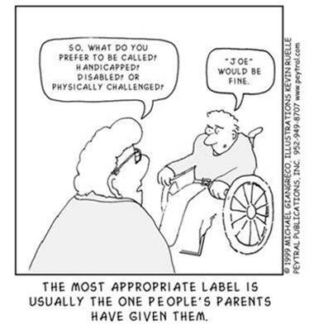
SOMETIMES WE NEED TO REMIND PEOPLE THAT WE ARE MORE SIMILAR THAN DIFFERENT
Notes:
Intro to next slide

Slide 16
8. highlight SIMILARITIES AND GIFTS
Let your family member’s glitter sparkle -- find ways to communicate their strengths and passions
Use fashion and pop culture strategically – consider asking peers what is popular so your family member invites comments on their clothing, phone apps, etc.
Emphasize Roles that are Valued by others -- brother, volunteer, girl scout, team member, etc.
Empower your family member with the same language their peers are using (even if you have to program it into their AAC device)
Find opportunities for your family member to take leadership and to help others, so they are not always seen on the receiving end

Slide 17
9. INVITE PEOPLE INTO YOUR LIFE & HOME
Make your home the place people want to be; make it a fun place to get together!
Sign your family member up for community groups and activities that involve people from your neighborhood, community, or school.
Invite others to do fun activities with your family
Get to know other families to strengthen your kids’ connections -- carpool, volunteer, host family dinners
If you are too exhausted to do all of this, find someone else to step in – use home support staff, adult friends, family.
Notes:
Spaghetti Dinner Example

Slide 18
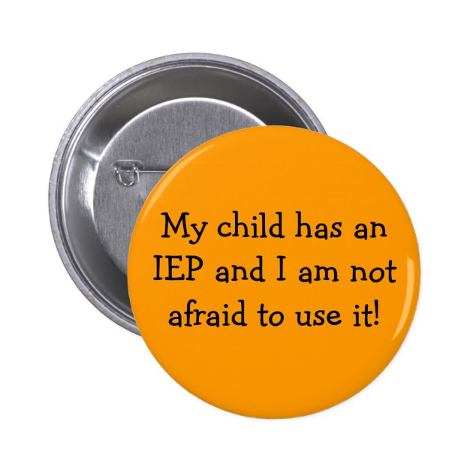
10. Use your iep, ISP and other tools
IEP for School: Remember, the school is responsible for your child’s social and emotional progress, not only their academic progress! Use your IEP to ensure they have regular, meaningful opportunities to socialize with peers who do not have disabilities.
ISP for Adults: It is easy for adult service providers to get consumed with “health and safety.” Remind them that research proves that relationships are a critical component to health and safety!
No Service Plan: Use the planning tools in this presentation to create your own plan, and revisit them regularly to monitor progress. Even better: do it with a friend!

Slide 19
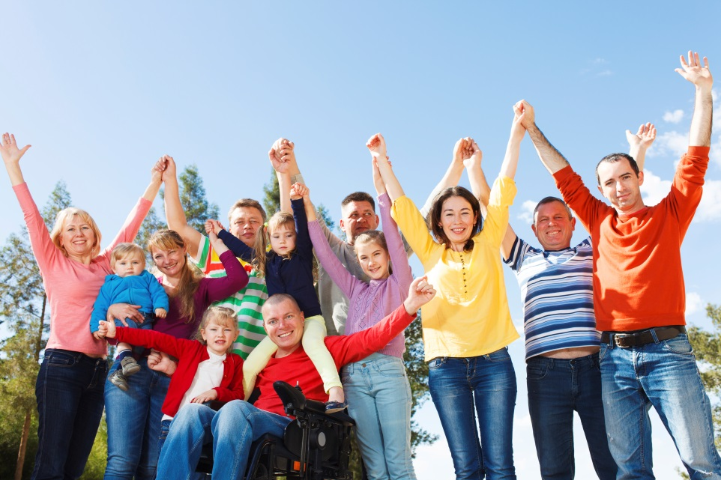
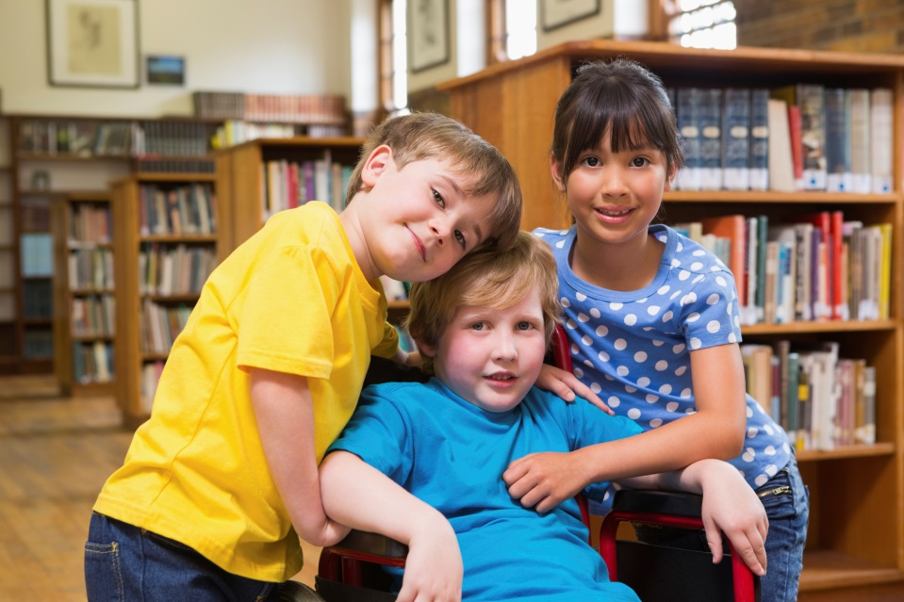
Let’s make it happen!

Slide 20
THANK YOU!
WHAT IDEAS OR SUCCESSES
DO YOU WANT TO SHARE?

