Slide 1

Making Friends in the Community
Where You
Play, Serve, and Worship
Prepared by Widening The Circle; Pathways to Friendship, a partnership between The Arc of Massachusetts and Massachusetts Department of Developmental Services

Slide 2
Pathways to Friendship: Where You…
Live
Learn
Work
Play, Serve & Worship
Notes:
Link to the website where you can download these toolkits at the end.

Slide 3
Building a Community of Belonging
This presentation will focus on what staff, family members, and individuals themselves can do to create opportunities for friendship through the roles of: athlete, teammate, musician, artist, student, activist, worshiper, engaged citizen.
These roles naturally offer a way to get people engaged in activities that are enjoyable and/or meaningful to them, showcase their gifts, and create a place to belong. While there are endless benefits to community participation itself, our focus here is on utilizing activities as a means to an end—to build friendships.

Slide 4
Take a moment and think of a friend in your life.
What is it you love about this person?
What things do you do together, or for each other?
Notes:
Read the questions: Notes: We often meet others because they like to do the same things we like to do or care about the same causes. We connect through shared interests in reading or baseball or theater or the Audubon Society or sailing or places of worship or dance or donuts—or a million other possibilities. Sometimes, these connections lead us into friendships.

Slide 5
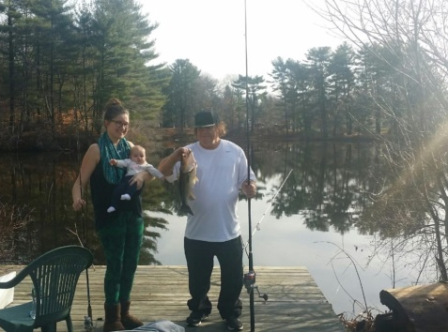
Friendship Is…
Freely-Given
Reciprocal/Mutual
Supportive
Trusting
Loyal

Slide 6
"Call it what it is"
Teachers refer to everyone as class, and when they recognize a pair starting to become friends, they use specific language to note it.
“I see you and Juan are enjoying one another’s company. It looks like the two of you are becoming friends!”
For people with intellectual disabilities, this is a critical part of accessing social roles and building capacity for friendships.
Notes:
Read Slide

Slide 7
"Call it what it is"
One must be able to recognize the difference between how it feels being with someone they’ve just met (or never met!) and
how it feels to be truly known and accepted.
Use better language instead of calling everyone on the bus/class/team friends. Try: teammates, class, players, artists, everyone, people, or y'all.
Notes:
Notes: There is also an element of autonomy and authenticity that comes with choosing your own friends, which makes those relationships all the more special.
read Slide

Slide 8
The Client Role and Opportunities to Contribute
One of the big ideas we are working from is the idea that in any society, good things in life are more easily accessible to people who have valued social roles.
On the other side, people who have roles that are devalued or marginalized have a harder time accessing those good things.
Notes:
Note: Social Role Valorization and Wolf Wolfensberger– include in references– there are multi-day workshops in MA on this topic, etc.

Slide 9
Valued Roles
Roles include titles like partner, athlete, leader, employee, parent, son or daughter, member, and yes, friend.
Roles come with perks. If you’re an athlete, you get to wear the uniform, give the high fives, celebrate after a big win.
Roles also come with responsibilities: you also must show up to practice on time, keep your body healthy, and show good sportsmanship.
Roles give us the chance to feel like “I’m somebody.”

Slide 10

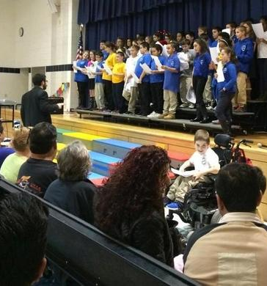
But…people with disabilities are often excluded from taking on many of the roles that hold the highest value in society and instead are limited to being clients for much of their lives.

Slide 11
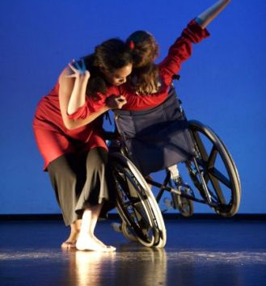
“We can transform lives and make lasting change in our society by helping people uncover their unique gifts or potential contributions, and then finding a place where those can shine.” (Reidy, 2001)
Notes:
Notes: “Wait a minute,” you say, “I’m just here to help a person make some friends, I’m not out to change the world.” We believe strongly that each these actions, seemingly small by themselves, sends a message of value, inclusion, and presence by bringing people with disabilities into true community participation rather than living parallel, segregated lives.

Slide 12

Loneliness & Social Isolation
Loneliness has a profound effect on
our minds, hearts, and our bodies.

Slide 13


Loneliness & Social Isolation
“An interesting thing about loneliness is that it doesn’t matter how many people are around you. It’s about how you feel about the quality of the relationships in your life.” (Masi et al., 2011)

Slide 14
Loneliness & Social Isolation
Isolation and loneliness decrease our immunity, increase the release of stress hormones, and make sleep more difficult.
Chronic stress ages our bodies, damages overall well-being, and can even be a risk factor for heart disease, type 2 diabetes, arthritis, Alzheimer’s disease, and other conditions (Psychology Today, n.d.).

Slide 15
Loneliness & Social Isolation
People with disabilities often have a social network which is limited to family members, paid staff, and other people with disabilities (Kersh, Corona, & Siperstein, 2013).
This may sound like a lot of people, but the difference becomes clear when we compare networks of people with and without disabilities.

Slide 16
What about other people already in someone’s life?

Slide 17
What About Family Members?
Family relationships are important to all of us. Some of us have very close relationships with family members—we may see each other frequently or be in touch through phone calls, emails, social media, shared activities, visit, etc.
Other family relationships may be more distanced, with little to no contact at all. Even for families who are very close, families and the individuals within them are stronger, healthier, and happier when they are connected to a wider community, including having friends. Family members can both support and hold back their loved ones at times.

Slide 18
What About Other People with Disabilities?
These relationships are incredibly important, and that should not be understated. There are lots of wonderful things that happen when people are given opportunities to build relationships with other people who have similar life experiences or identities. It’s even backed up by lots of research!
However, it is a problem when we assume that these are the only relationships people can, want to, or should have.
Notes:
Our service systems are already structured to encourage and even enforce these segregated relationships. We need to move beyond these by creating opportunities for the people with and without disabilities to become friends.

Slide 19
What About Staff?
Staff support is invaluable in helping people with many of their needs. However, these are functional, paid relationships: the individual has a specific need for support, and staff are assigned to fill that need.
Good staff develop trusting and respectful relationships with the people they serve, get to know them well, and commit to this role for extended periods of time.
Notes:
How would it feel if the most important people in your life were paid to be with you?

Slide 20
What About Staff? (continued)
They are often very caring and express this care in ways similar to that of friends; however, if a staff member gets a new job or is assigned a different role or shift, they usually end their involvement with a particular person. This cycle repeats itself across the spaces where people with disabilities are segregated, whether in living situations, day or work programs, etc.
If a former staff person continues a relationship with someone they used to support, this can become a good friendship.
Notes:
Add to slide or notes: How would you feel about your life, if the two or three people you most count on were paid to be in your life, assigned by the state?

Slide 21
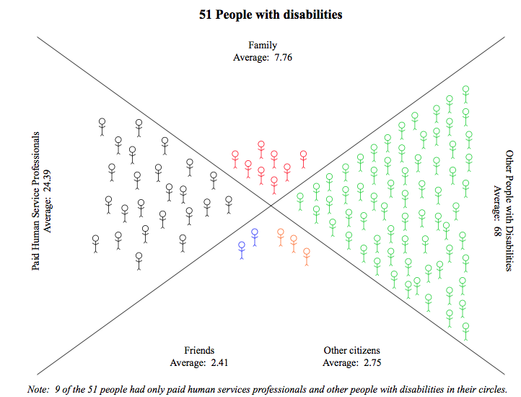
Who is in their social network?

Slide 22
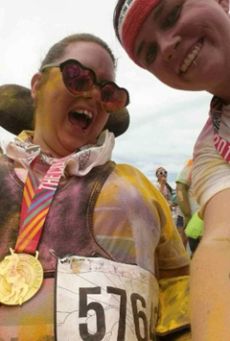
Angelina
Angelina is 24 and lives with two other young women around her age. Angelina expressed her love for participating in road races. She started participating in such races over a year ago when her previous program manager, Jess, asked if she would like to participate in one with her. Since that time, she has participated in more than six races.
They have pre-race brunches and many post-race activities, which have provided additional opportunities for Angelina to connect with others and make friendships outside of her service circle. Recently, Jess resigned from her relief staff position and is genuinely Angelina’s friend.
Notes:
Jess had built such a strong relationship with Angelina during the time she worked at Angelina’s home that when she transferred, she asked to stay as relief staff so they could still participate in races together. Jess has really acted as a community connector for Angelina within the 5K racing community.

Slide 23
Leisure
Leisure is often thought of as “free time,” or any time we have when we don’t have to be doing something else (work, personal care, caretaking, household chores, etc.). It’s when we do activities for their own sake. It can also be thought of as a state of mind or a person’s perception that they’ve chosen what they’re doing and are free from being controlled by others or obligations.
That means the focus is on the doing, the experience of an activity—rather than on the outcome.

Slide 24
Recreation
Recreation is socially organized activities that benefit a person or society, and these activities help to recreate or restore people in mind, spirit, and body. Recreation is intended to be good for people, not just to get them back to work, but to live a full life.
In recreation, we are interested in the experience itself and also the outcome of feeling better. Leisure may be destructive (in gambling, for example), but recreation is always intended to be beneficial. People engage in recreation for fun, rather than out of obligation or being forced to do so.

Slide 25
Try Something New!
If someone has never tried kayaking, playing pickleball, bird watching, or gardening before, it’s hard to know whether they will like it or not.
Trying different activities allows a person to experiment and find interests that they can share with others. Don’t just ask what they want to do- that won’t elicit that new opportunity. Propose it, try it out!
If someone already has some skills in an area, recreation can give people an opportunity to shine in ways that academic or vocational settings may not.

Slide 26
Choice + Encouragement
Ask an open-ended question…but don’t stop there!
Offer more than one option…but don’t stop there!
Let’s try it together!
Think outside the box!
You don’t know if the role fits until you try it on!
Notes:
ASK: What if the person is unable to communicate their interests? How would you engage the person to determine interests?
Answers/Note: Communication device, picture board, interest survey, watch a video of someone doing the activity and watch their reaction! What if you’re unsure if they enjoyed the activity/experience? Watch for their reactions!

Slide 27
Barriers to Full Participation
We also acknowledge that there are many barriers that exist to recreation participation itself, including physical access, programmatic access, transportation, and attitudes.
We will share some great resources on recreation inclusion that can help you think about breaking down participation barriers.

Slide 28
Health Benefits of Recreation
Physical Health
Reduces obesity
Reduces risk of chronic disease, including:
Heart disease
Diabetes
Cancer
Osteoporosis
Boosts immune system
Increases life expectancy
Mental Health
Reduces depression
Relieves stress
Improves:
Self-esteem
Personal and spiritual growth
Life satisfaction
Social Benefits
Reduces crime
Encourages volunteerism
Promotes stewardship
Unites families
Builds cultural diversity and harmony
Deters negative behaviors
(California State Parks, 2005)

Slide 29
What about Specialized Programs?
People with disabilities may “choose” segregated settings because of lack of support and insufficient experience in integrated settings (Sylvester et al., 2001). Older people with disabilities are especially prone to participate in very few activities (usually bowling, sing-alongs, or dances) that are very segregated, often due to a lifelong lack of opportunity to make choices and try a broad range of activities.
We realize that people may have a number of reasons for making such choices, and we also realize that people get great joy and may make good friends in these types of activities.

Slide 30
Specialized Programs
However, we believe strongly that segregated activities continue to reinforce the idea that people with and without disabilities are more different than they are alike, and that it requires specialized knowledge to interact and be in relationship together.
Chances for friendships between people with and without disabilities are highly unlikely to happen in these kinds of programs or activities because the client role is still at play.

Slide 31
Specialized Programs
If people are currently involved in such activities or programs, it may be helpful to think of that participation as a springboard to something more inclusive.
Use these opportunities to practice skills and take baby steps, but make sure there is a plan to transition out or add a more inclusive option.
Someone doesn’t have to leave their Special Olympics team, but perhaps they can join another team at their local YMCA/JCC or find a group of people who play a weekly pick-up game at the park down the street.
Notes:
Specialized, “inclusion” hour at the pool, “adapted” (not adaptive) classes, for “all/diverse abilities” = almost always segregation

Slide 32
Civic Engagement
There are numerous local opportunities for people with and without disabilities to contribute to their communities. Every town or city relies on volunteers to fill seats on committees that deal with education, finances, recycling, conservation, cable TV, Councils on Aging, culture, historical issues, housing, disability access, parks and recreation, and more.
Your city or town likely has a website that lists all its committees and contact information, or you can call the town hall directly for that information.
Notes:
NOTE: The teacher could choose the option of an exercise- have participants think of every civic opportunities in their town/community. Where in your town could they use volunteers?
Every town and city also abounds with civic organizations like Lions Clubs, Kiwanis, Rotary, political organizations, cultural and arts, friends of the library, community theatre, election campaigns, historical commission, human services, animals, environmental, and others. Some may be loosely affiliated action groups, while others may be formalized nonprofit organizations. Either way, they rely heavily on volunteer members of their board of directors and other committees. All of them would benefit from having people with disabilities as part of their governing body or other project-based groups.

Slide 33
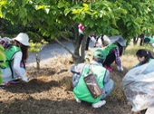
Civic Engagement
It’s easy to do an internet search of what’s local and find out what you may need to do to join.
Make sure that with any role someone wants to take on, they won’t be working alone.
Even periodic, tedious tasks can be fun and a source of connection, as long as you’re in a big group of people chatting and doing the same!
Notes:
It’s a good idea to research who is already on the committees or are members of organizations. You may find out that you already know someone who is a member and can approach on behalf of the person with a disability.

Slide 34
Mark’s Story
Like many young people with Asperger syndrome, Mark has a few very keen interests for which he is very devoted. It’s no surprise that he’s a Red Sox fan, something that has caused him both incredible joy and not-so-nice behavioral outbursts, as it has for so many other fans.
It was a little more of a surprise, though, that he also honed his attention from an early age on recycling. There was no wastebasket in the home that was not torn apart so he could be sure that his family wasn’t throwing away something that could be recycled.
Notes:
Read Slide and then continue….
Serendipitously, the local landfill was being closed, and Mark’s town was convening a recycling committee to help plan an expansion and redesign of the recycling facility and process.
Mark’s family supported him to apply for a position on the committee, and he was among those chosen. It was a proud moment when he was sworn in by the select board as the youngest member of an official town board—at the age of nine!
Mark met regularly with the other committee members, both at the town hall and at the site of the facility. His input was valued and considered, and within two years, the town had a fully functioning, efficient recycling program in place.
While on the committee, Mark made connections. It is notable that when he was old enough, because of this earlier civic engagement, Mark was offered a summer job by the town’s highway department, which oversees the recycling facility.

Slide 35
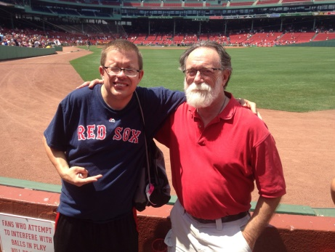
Studying & Learning from the Ordinary
Take the time as you support people to think about how you would approach something in your own life. How would you plan a block party? Learn how to play a new game?
If you’re not sure, ask someone who might know.
Notes:
We don’t often think about the steps we take in everyday life, break down how we think about something, and consider how we put all of that into action. When it comes to joining a new community or trying a new activity, how do you learn about the space and expectations, prepare for the experience, and become involved with it? How do you establish yourself as a member of that community and deepen your role, and then how does it become a central part of your life?

Slide 36
Find & Enlist Welcomers
Welcomers or “Gatekeepers” can be terrific allies in helping someone new fit in. They can also help you understand the culture of the organization. Different organizations have different expectations of their members.
There may be certain ways to dress, things you should bring, a specific oath, prayer, or salutation to kick off meetings, an expectation of a modest donation, a rotating responsibility for bringing food, etc.
Notes:
Deeply connecting people with disabilities within an activity or organization is much more successful if someone within that organization, rather than an external person (a staff or family member, for example), is helping them take those steps.

Slide 37
Faith Communities
Churches, synagogues, mosques, temples, are much more than just buildings. They symbolize the coming together of people who share many of the same values, beliefs and traditions.
At their best, they evoke a deep sense of community among the congregants, a word whose Latin roots means “to collect (into a flock); united.”

Slide 38

Faith Communities
Faith communities can provide their congregations with spiritual, emotional, and social supports, and can be very fertile ground for friendships between people with and without disabilities.
Most faith traditions have a variety of levels at which their parishioners can be involved and many roles that people can play. There are usually worship services that occur at various times depending on the specific religion. These can be quiet and contemplative or raucous and celebratory, appealing in different ways to different people.

Slide 39
Faith Communities
A couple of projects have been developed in Massachusetts that focus specifically on helping faith communities reach out to and include people with disabilities. For more information you can use the resources below:
Bridges to Faith (www.bridgestofaith.org) serves the Greater New Bedford area.
Spiritual Connections (http://peopleinc-fr.org/programs/spiritual-connections/) serves the Greater Fall River area.
Yachad New England (https://www.yachad.org) Serving the Jewish community in the New England area.

Slide 40
Roles available in many congregations
Lay minister
Usher
Prayer chain coordinator
Musician
Choir member
Elder/vestry/council representative
Coffee hour host
Bible study member
Lector
Events planning committee
Small group leader or host
Greeter
Usher
Prayer book organizer
Choir member Librarian
Kitchen crew
Shabbat kiddush & lunch crew
Mitzvah program volunteer
Volunteer at festivals
Volunteer in religious school
Sukkah builder
Holiday decorator
Tu bishvat tree planter
Purim carnival planner
Passover Seder volunteer
Elderly outreach volunteer
Book club member

Slide 41
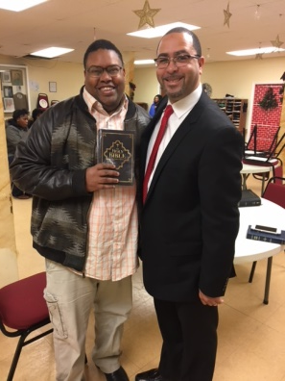
Greg’s Story
When he moved into his new home two years ago, Greg spoke with staff and expressed an interest in getting out into the community, stating that he really enjoyed attending church.
With support from a staff person familiar with some of the local churches, Greg was able to find a church to attend regularly, and after about a year he made the decision to officially become a member.

Slide 42
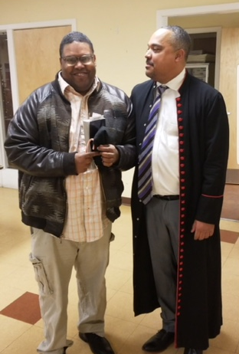
Greg’s Story
Greg expanded his role in his church community, joining the Usher Board Committee. On a typical Sunday, Greg can be seen greeting church-goers, passing out bulletins and welcoming visiting guests. Greg takes this role very seriously, having bought a new suit and by getting regular haircuts so that he fits in with the other ushers. The ushers also meet on Wednesday evenings, so Greg often stays late to eat dinner with the group.

Slide 43
A Valued Role as a Bridge to Friendship
Greg has grown especially close with one usher. After church on Sundays, Greg generally goes out to eat with his friend, who then drops him off back at home. Greg often invites his friend over for dinner. They have several common interests and in the past few months have gone to the movies and attended two art workshop classes together. Staff no longer accompanies Greg to church or on outings with his friend.
Notes:
It is important to note that prior to his deep involvement with his church, Greg was on a behavior plan; however, he has experienced a significant decrease in anxiety, which he struggled with in the past. He has also reported increased feelings of self-assurance and happiness, and his behavior plan has been phased out. This is a major milestone for Greg. Not only has this progress provided a major boost in his confidence, but he is actively seeking new friendships by participating in other activities, such as book clubs and adult education classes.

Slide 44
Lessons from Greg’s Story
Focus on the Person’s Gifts
Listen & support for the things in which they are truly interested is important! What role in church would take advantage of his Greg’s gifts?
Enlist a Welcomer/Gatekeeper
Support staff was already familiar with the church that Greg wanted to attend and also knew some of that church’s members. He was able to lay some groundwork ahead of time, including encouraging the existing church members to extend a welcome to Greg.
Notes:
Greg was very clear that he was interested in attending a church. Staff listened to this and invested their time in making that connection happen. Being sure that people receive support for the things in which they are truly interested is important!
It was immensely helpful that one of the support staff was already familiar with the church that Greg wanted to attend and also knew some of that church’s members. He was able to lay some groundwork ahead of time, including encouraging the existing church members to extend a welcome to Greg. Identifying gatekeepers in the community (outside of the human service system) can enhance the chances of someone being part of a group and establishing relationships, including friendships.

Slide 45
Lessons from Greg’s Story
Consistent Participation
Staff realized that being a regular participant at his church was important. Being in the same place with others, at the same times, and over a long period of time is an essential ingredient in setting the stage for friendships to develop.
Crafting Valued Roles
After attending church for a while, Greg was supported to become an official member. This likely involved a bit of learning (e.g., of songs and rituals) and a commitment from Greg (and his supporters). This church membership was a valued social role for Greg to fill.

Slide 46
Lessons from Greg’s Story
But, tellingly, Greg’s supporters did not stop at church membership. They helped Greg assume an even more valued social role as an usher and member of the Usher Board Committee. Too often, people with disabilities are not supported to expand their roles within groups. The invitation and the coaching came from other members of the church, not human service professionals.
Greg (and his supporters) recognized that to be an usher included looking the part for that important role. Buying a new suit and getting regular haircuts helped Greg both fit in (as one of the ushers) and stand out (as a valued member of his church community).

Slide 47
Lessons from Greg’s Story
Greg’s relationship to his fellow ushers (especially one of them) grew. But they were not “just” friends at church (although that’s pretty good). Greg was supported to attend the weeknight meeting of the Usher Board and to go out to dinner with them. He was supported to invite a fellow usher to his home for dinner. There were opportunities to explore other interests beyond church with the people he met in church.
The reciprocal nature of these relationships and the expansion of connections beyond the original place of contact (“transcending context” as Dr. Zachery Rossetti, Boston University, refers to it) are important parts of true friendships.

Slide 48
Lessons from Greg’s Story
Greg’s support agency was wise in “letting go.” Staff were eventually able to phase out their supports so that they no longer needed to accompany Greg to church, the Usher Board meetings, or other activities and events with his friends. The human service professionals were the initial bridge builders but the sooner the welcomers among his fellow church members can become his primary supporters, the better!
Bonus: this freed up the staff to help other people they served connect in the community!

Slide 49
Lessons from Greg’s Story
Greg’s new friendships and valued roles have given him new confidence. He is willing to try new things.
These same friendships have also helped decrease Greg’s anxiety and behaviors that “required” him to have a formal behavior plan. Phasing out that behavior plan is a good indicator of the power of friendships!

Slide 50
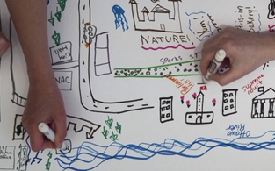
Tools to Access Opportunities for Friendship

Slide 51
Focus on Gifts
Both the person with a disability and any support folks should know what the person with a disability can offer, what strengths they have, and what unique gifts/abilities they bring to a group. Then, make it clear to people in the community organization what kinds of contributions the person is able to make. This is not about proving value, but rather to make those contributions available and visible to others
Notes:
Connections like this have several benefits, according to McKnight and Block (2010):
The giver sees their own value in the appreciation of those receiving their gifts.
The receiver sees the value of the giver in the gift.
3. The community becomes more valuable as the value of that gift is shared to benefit others.

Slide 52
Finding Activities
You can walk through this yourself, or with the person you support.
What kind of activity do I want to try?
What kind of roles are available?
Where in my area can I find it?
What do I need to do to prepare?
Notes:
The possibilities are endless, whether in recreation groups, civic groups, or faith communities. Some people may like active, noisy things to do or to be part of a team, while others might prefer a quiet hike or fishing trip, or to take a leadership role for a cause they care about. This could be finding a new opportunity or deepening involvement or changing roles in an existing integrated activity. As long as the activity could lead to friendships, game on!
Preparing would include what to wear, what to bring, and how to act in order to be welcomed.

Slide 53
Try Something New!
If someone has never tried kayaking, playing pickleball, bird watching, or gardening before, it’s hard to know whether they will like it or not.
Trying different activities allows a person to experiment and find interests that they can share with others. Don’t just ask what they want to do- that won’t elicit that new opportunity. Propose it, try it out!
If someone already has some skills in an area, recreation can give people an opportunity to shine in ways that academic or vocational settings may not.

Slide 54
Choice + Encouragement
Ask an open-ended question…but don’t stop there!
Offer more than one option…but don’t stop there!
Let’s try it together!
Think outside the box!
You don’t know if the role fits until you try it on!
Notes:
ASK: What if the person is unable to communicate their interests? How would you engage the person to determine interests?
Answers/Note: Communication device, picture board, interest survey, watch a video of someone doing the activity and watch their reaction! What if you’re unsure if they enjoyed the activity/experience? Watch for their reactions!

Slide 55
What kind of interests, opportunities, and roles are out there that can build pathways to friendship?
Start by thinking about the person you support: What do they love? Where do you notice them at their best, happiest self?
Interest inventories can help introduce a person to new kinds of activities and get an idea of what sorts of things they’d like to try (or not!)

Slide 56
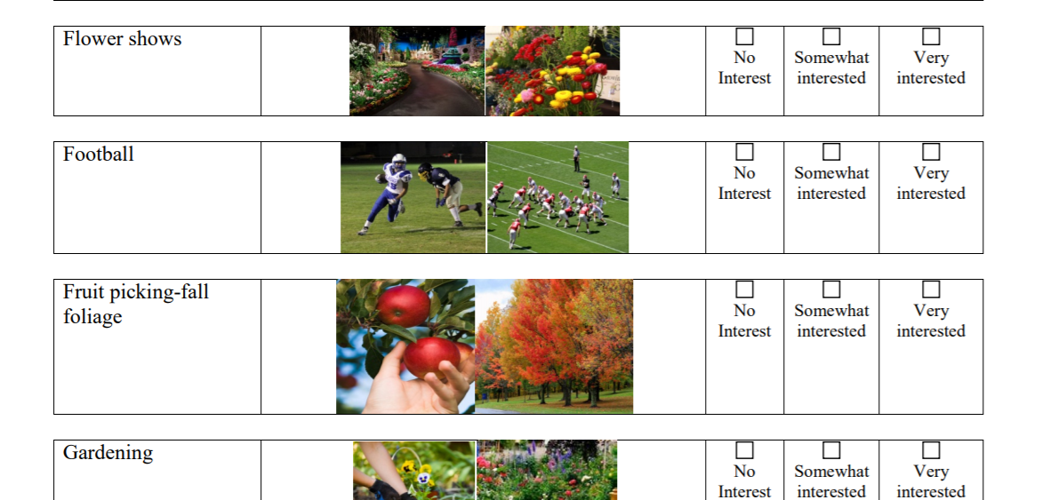

Slide 57
Where to Start Looking
Check with your town or city hall to find out who works in your community.
The recreation department is a great place to start, but also check with the community development department or even the mayor’s office.
Find out which local YMCA serves your community; it might be in a neighboring town.
Libraries offer many programs and often know about little groups that meet there.
Social websites like MeetUp.com can be great resources.
Regional organizations, such as the Appalachian Mountain Club, Audubon Society, offer many opportunities.
Clubs like the Rotary, Lions, local coalitions, and identity groups (other than around disabilities: think heritage, ethnicity, or LGBTQ groups) can be another source of inspiration.
Companies like L. L. Bean and REI offer outings.
Check out classes from community/adult education programs instead of segregated classes

Slide 58
What Kind of Roles are Available?
In most activities, there are multiple roles people can take on with varying levels of engagement.
Community Theater: actors, scene builders, stage managers, ticket-takers, boards of directors, fundraisers, etc.
Church: greeters, ushers, altar servers, coffee-hour hosts, food bank volunteers, choir member, etc.
Over time, these roles can become a part of our identities. Thinking deeply about what the person you’re supporting can contribute to the program and what role they can assume meaningfully to share their skills and self.

Slide 59
Some roles are better for getting to know people.
Don’t just be a member at the YMCA—join a committee or project-based group.
When people are working hard together, connections happen. Some examples are political campaigns (including for causes and movements, not just for candidates). One could be a sign holder, a community organizer, a block party planner, a mailing helper, a door-knocker, or a town celebration planning committee member.
There are lots of groups in which no one gets paid and who need more people to help them do the work!

Slide 60
A Word on Tokenism
Tokenism is “the policy or practice of making only a symbolic effort (as to desegregate) or the practice of doing something (such as hiring a person who belongs to a minority group) only to prevent criticism and give the appearance that people are being treated fairly”
Instead, we seek valued roles in which the person can be fully engaged as a real participant.

Slide 61
Where in my area can I find it?
Multi-week classes where you sign up for a group of classes at once: A six-week art class, for example.
Regular drop-in times: Perhaps a sewing group at the library?
Pick-up games: The group of people who play chess at the park every day at lunch, or the group that plays basketball at the YMCA on Friday nights. Whoever shows up is welcome!
Competitive leagues: Only choose these if a person is moderately skilled at the activity already.
Recreational leagues: A better fit but can be tricky. There can be an undercurrent of competitiveness and pressure in even the most relaxed leagues. Ask around about the culture of a program and find leagues that are truly focused on fun.
Notes:
In the recreation industry, there are many different places where opportunities may happen. For friendships to develop, a priority must be given to activities that happen regularly over time, not to one-time events. For example, a summer concert in the park is not conducive to building friendships, while an open-mic night where regulars take turns performing songs or reading poems might be a great place to meet someone.

Slide 62
Where in the area can I find it?
Membership programs: Try local pool or community center at times when regulars tend to be around. Choose a specific way to be involved to start getting to know other members.
One-time events: Not ideal here! An exception is if a particular organization has a core membership that attend the events on a regular basis. To make this work, a person has to show up frequently and participate.

Slide 63
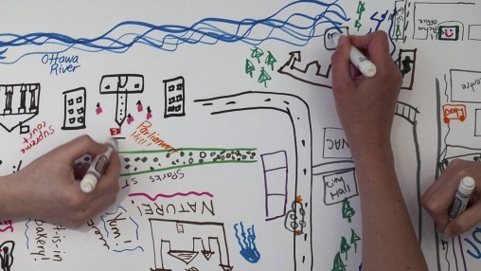
Community Mapping

Slide 64
Community Mapping
This illustrates those places that a person already frequents, which might include a work or volunteer site, a faith community, the family home, the YMCA, the grocery store, the barbershop, a local park, etc.
Community settings and human service settings should be included, along with places that are regularly visited (e.g., a day program for daily engagement or a gym for weekly exercise) as well as places of only occasional or annual visits (the local fairground for the annual fair).
Notes:
Although the word map is used, the community map can be documented in the form of pictures or lists.

Slide 65
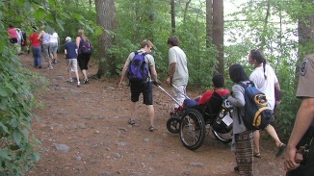
What do I need to prepare?

Slide 66
Clothing & Gear
Contact the program leader and ask for a list of what someone needs to bring, what is provided, and for any other little tips. For example: that people have been taking turns bringing snacks for the group, you’d need to plan for when it will be your person’s turn and to learn what kinds of things people enjoy snacking on.
What kind of gear do participants have? Is there a culture of bringing a reusable water bottle or coffee mug? Do they need a pair of binoculars, a backpack, or bug spray?
Dress appropriately to fit in with the group. A member of a hiking club will dress very differently from a choir member.
Notes:
We only get one chance to make a good first impression, so helping a person to look the part to get into the role is important. This includes both equipment and clothing, but also practicing what might be expected in advance. Think of how you might behave at a first gathering or what you would want to know or have with you.
Ideally, we could even go beyond “appropriate” to help the persons clothing and gear to be cool or stylish. We want to help people to not just fit in but to be welcomed as members.

Slide 67
Clothing & Gear
This is not the day for sweatpants and an old fun-run T-shirt, unless it’s a gym workout class where other people are also dressed similarly. While not required, a new outfit can help boost confidence, and many stores are now offering accessible/universal clothing that looks good and is easy to put on independently.
Gear for many activities can get expensive. Rent, borrow, use local free-stuff pages (Freecycle, Craigslist, and Buy Nothing Project, for example) to see if you can source quality items for free or a low cost. Use your network and see if friends or neighbors have an item you can borrow. Be a good steward and remember to return it!

Slide 68
Practicing what might be expected in advance
Learn the jargon/language used by the particular group. For instance, sailors use a very different set of words/phrases than bird-watchers.
Pre-teach the skills or rules. If you don’t know them, ask around and find someone who can help.
Understand the different rituals that are important for true membership in a specific group. This may be especially important in faith communities, for example.
Social stories are helpful tools that can help a person understand what they might expect before, during, and after a new experience.

Slide 69
Visit the Space in Advance
Preview the space as many times as the person needs when it is not full of people. Where are quiet spaces where they could take a break? How do the seats feel? You can even send someone who knows the person well first and see if there are any red flags (screaming children, for example).
Observe the program prior to attending, if possible.
Preview the schedule, perhaps making a visual schedule if this is helpful for the person.
Do a dry run. Get all packed, dressed, find out how long it takes you to get there, etc. What might traffic look like at that time of day? Where should you park? Do you need coins to feed a parking meter? Some of the most valuable times to meet people are before a program starts and after it ends, so you don’t want to miss that informal time. Also, showing up late can add a stigma that does not leave a great first impression.

Slide 70

Recruiting a companion/welcomer beforehand
A person who is already a member and could be a companion to the person supported. A “tour guide” to help introduce the person to a whole new world.

Slide 71
Adaptive Equipment
Soccer balls with rattling discs inside so people with low vision can more accurately find the ball.
A bite-on shutter release for camera (for people with low hand control but good mouth control).
Beach wheelchairs that can go from the sand into the water.
A head or hand activation switch to turn on an appliance (e.g., a CD player, blender, video game, popcorn machine)
Baseballs that beep.
Visual timers to let someone know how much time is left.
Bocce ramp (like a bowling ramp).
Adaptive fishing rods for people who have difficulty with hand strength or grip.
A gardening seat that swivels and rolls with long-handled tools.
A sailboat that can be steered with a sip and puff machine (we found one at a local sailing program!)
Notes:
Adaptive equipment helps people with disabilities more fully participate in recreational activities than might otherwise be possible. There are a ton of products out there for purchase, but some solutions are very inexpensive and easy to create. It’s best to give something a try before you buy it, and each person’s needs are different, so their equipment may need to be, too. Adapt only what will help a person become as independent in that activity as possible.

Slide 72
Adaptive Equipment Resources
A few adaptive equipment loan or rental programs exist so people can try something out instead of buying it.
Here are some resources in New England:
Northeast Passage (Durham, NH): Rent equipment, particularly for outdoor pursuits, including all types of cycles, sports chairs, gardening equipment, bocce ramps, and more.
SMILE Mass (Sudbury, MA and the Cape): Borrow beach wheelchairs, high-performance running strollers, jogging strollers, and some cycles.
Perkins Library: Become a library patron and receive free access to talking book players with tens of thousands of titles. Have the newspaper read to you each morning. Hear an audio-described movie. Explore different languages.
Massachusetts Department of Conservation and Recreation’s Universal Access Program: Get beach wheelchairs at dozens of public beaches, visit accessible fishing piers, and browse lists of accessible trails.

Slide 73

Adaptive Expectations
Some activities might need adapted rules or expectations rather than equipment. For example, a book club member does not necessarily need to be able to read. Instead, they could listen to an audiobook or have a friend summarize the current book before they participate in the discussion.

Slide 74
How to Use Your ISP or IEP to Promote Friendship and Connection
Whatever the person’s goals, they are likely to have a connection to relationships or create opportunities to expand social connections, and we would expect those connections to be included in some way in nearly all ISP objectives and not be isolated to a single objective targeting friendship.

Slide 75
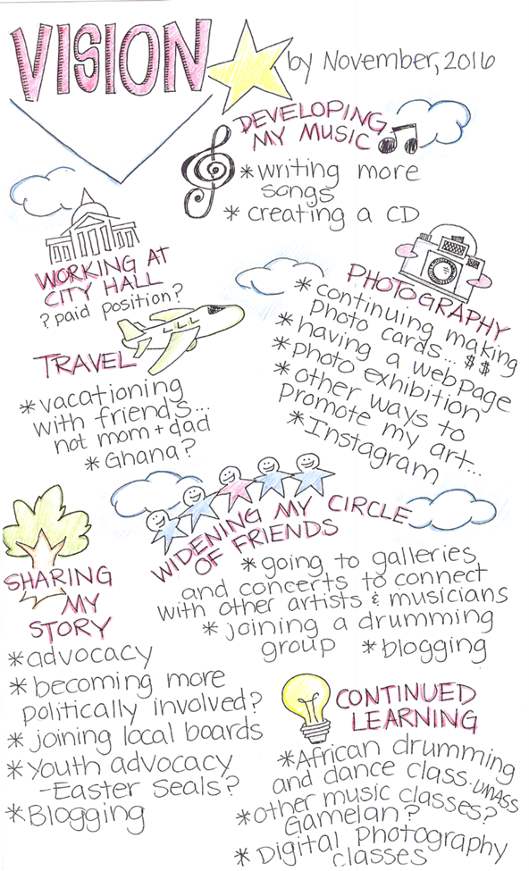
Setting Direction
The vision statement is developed by answering four key questions:
What do they identify as important activities and relationships to continue to be involved in? What other things would they like to explore?
What do they think someone needs to know in order to provide effective supports?
What do they think are their strengths and abilities?
What would they like to see happen in their life over the next two years? Who might this person become?
Notes:
The first question focuses in immediately on relationships that are important to the person. Supporters should go on a treasure hunt to identify and record every detail of the person’s current and previous social network, as well as identify the activities the person enjoys, with the goal of maintaining them to the greatest degree possible through changing life circumstances. It also provides an opportunity for the person to dream of new activities and relationships to explore in the future.
The second question offers the person the opportunity to identify what helps them the most and what gets in the way. This is often a question that is difficult for people to answer, but perseverance in identifying the person’s preferences in how they receive support will encourage success in addressing goals for the future. Things to pay attention to are the individual’s rhythms and routines, what types of environments are most comfortable in, and whether they need time to feel out a new situation or are the type to jump into a new experience with excitement. Get to know what the best fit is for the individual.
The third question provides information on how the person perceives their skills. By focusing in on relationships in addressing this question, supporters may identify hidden opportunities or obstacles to relationship. For example, a quiet person may describe themselves as shy, but it also makes them a good listener, something they might not highlight. Someone else may identify themselves as a good friend but doesn’t always make note of important events in their friends’ lives. Identifying conflicts between an individual’s self-perception and actual abilities will strengthen the team’s efforts in promoting relationships.
The fourth question tells the ISP team what is most important to work on now, and what the person’s goals for the future are. The individual should be supported to be specific about what they want out of life, especially in the realm of relationships and community connections. Do they want to reconnect with old friends? Establish a romantic relationship? Learn how to ride a bicycle? Have greater independence? Encourage people to imagine the life of their dreams!

Slide 76
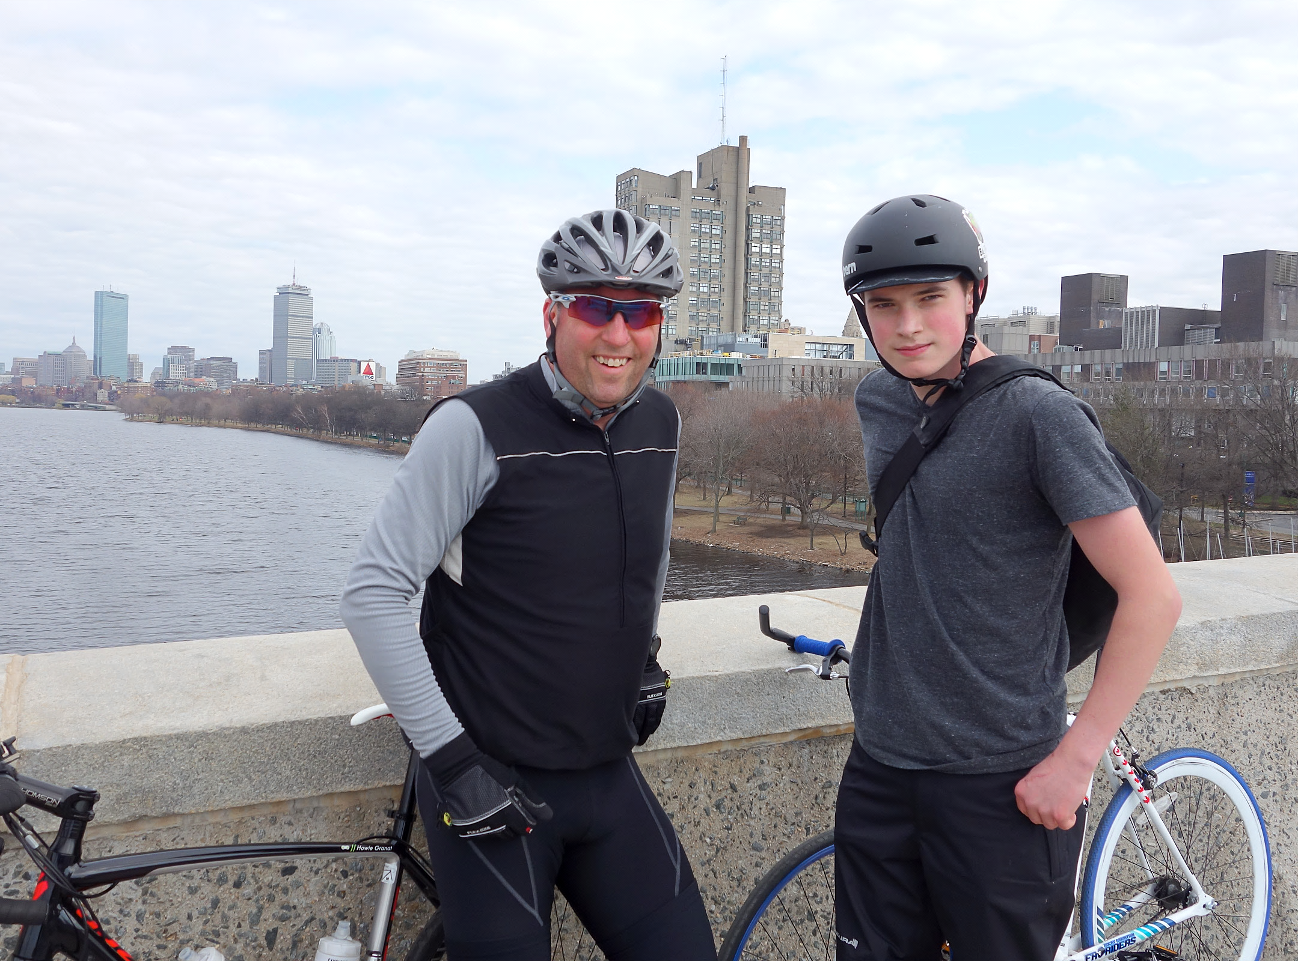
Friendship Goal
Goal: Devon will learn to ride a bicycle in his neighborhood.
Learning to ride a bicycle can lead to a biking buddy, gaining independence leads to mutually supportive relationships with neighbors.
Notes:
***Think about this more***

Slide 77
Friendship Goal- An Example…
Devon will have begun to make a friend by this time next year as demonstrated by:
1) Several repeated conversations with one or more people in the neighborhood.
2) Engaged in an activity with the person more than 3 times.
3) Has spent time with the person outside of the planned bicycling activity.

Slide 78
How to Use Your IEP to Promote Friendship and Connection
The IEP should be used to facilitate all aspects of an individual’s needs, not just educational requirements. Socio-emotional activities that enhance friendships and community activities are imperative for developing leisure and vocational skills as well as socio-emotional growth.
In order to promote connections and friendships in the IEP, it is important to understand the individualized supports accommodations and goals needed to access programs and activities.
Notes:
To facilitate and develop friendships, social opportunities must be available to the student. What supports are needed for the student to make connections and friendships at school? Review the current supports the student utilizes to participate currently in the educational setting and determine whether those supports are needed to access extracurricular, nonacademic activities. Determine what activities may interest the student. Social activities can include meals, recess periods, athletics, recreational activities, special interest groups, clubs sponsored by the school, etc. What will it take for the student to be successful participating in the chosen activities? Will they need a one-on-one to support them or a person to assist in facilitating a conversation? A peer mentor is an option as well, depending on the individual’s needs.

Slide 79
The Americans with Disabilities Act
When starting a new activity, you want people to welcome you in, which means finding a group that is the right fit. Bullying your way in doesn’t work. That said, if an organization refuses access, you may choose to let them know they have legal responsibilities to include people and know that your fight may pave the way to better access and community inclusion for other people in the future.
Have questions about the ADA and legal rights? Visit: www.newenglandada.org
Notes:
The Americans with Disabilities Act (ADA) is a comprehensive federal civil rights law signed in 1990 that prohibits discrimination in all aspects of life based on disability. While it doesn’t address relationships, knowing basic rights and key terms can be helpful as you get started finding new recreation or civic opportunities. We feel strongly that people need to be aware of their civil rights when it comes to community access, and unfortunately, sometimes the only thing that creates more opportunities for inclusion is empowered people speaking up for rights. Please note that nothing in this section should be construed as legal advice; rather, it provides a brief introduction to a complex document and process.

Slide 80
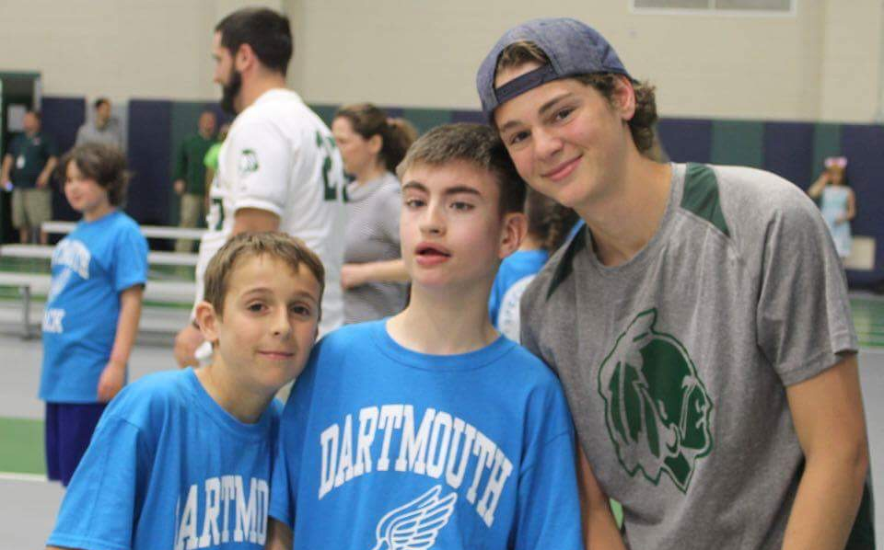
Tips for Building Friendships

Slide 81
This is a team effort.
Perhaps it’s not a direct care staff who actually goes on the bird watch, but it’s their job to assist the person as they get dressed, fed, and ensure they have their binoculars.
The nurse has to prep any medications to be taken on-site.
The program manager might need to allow direct staff to flex their hours that week or do a swap with another staff person who really enjoys being outside to take the person.
You are the bridge builder (facilitator/initiator) and part of your role is to recruit welcomers in the community.

Slide 82
Be the champion by role modeling!
Train other staff by bringing them along, helping them know how to support relationships.
You are also role modeling respectful and supportive interactions for the people in the community. How you give support, directions, and guidance—using positive language, encouraging independence, using an age-appropriate tone, etc.—is crucial.
Many folks often have little experience interacting with people with disabilities and may be hesitant or not comfortable. Your thoughtfulness can make the difference for someone who might be a potential new friend!
Notes:
There has to be an expectation first, before any training. “When we go out, you are not just a driver or pushing someone’s chair. There are other things that you’re doing, because this is what’s happening out there.” Otherwise, it can turn into just getting people from A to B without the other support. There is quite a bit of learning gained from experience and by just talking to the person about what they need from you at the activity.

Slide 83
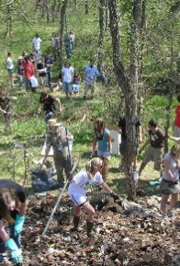
Be prepared to participate.
How staff or family members act in the program and how engaged they are plays a big role in how accepted the person with a disability can be.
If the activity is also for adults, the staff or family member can participate too. You can ask for a waived fee for staff as a reasonable modification
Notes:
Instead of sitting around reading a magazine or using their phone and waiting for a person to be done, staff should be getting to know people, participating in the activity, building connections, and hopefully, enjoying themselves in the process. Rather than it becoming about your experience, this is all with the focus on a positive experience for the person you’re supporting.

Slide 84

Supporter Role
You are kind of like a backseat friendship driver, trying to be as invisible as you can, but also stepping in as needed, in a way that feels as small as possible to get the effect you want.
Notes:
Read Slide
Perhaps you notice another participant wearing a shirt with the person’s favorite band. You could mention that to either one of them as a cue to start up a conversation or to suggest an activity outside the program so the friendship can transcend the context.

Slide 85
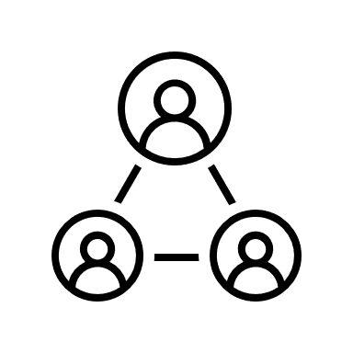
A Note on Safety
Perkse notes that there is “always risk and a chance for failure and pain” in any attempt to build close relationships, but that we “have yet to completely evaluate what we do to the human dignity of a person when such relationships are denied” (p. 198).
Notes:
There are very real reasons to be concerned for the safety of people with disabilities, including the fact that they are twice as likely to be sexually assaulted as the general population (Stone & Jones, n.d.). However, many people who care for people with disabilities tend to be overprotective, without allowing for the person’s individuality and growth potential.

Slide 86
A note on Safety (continued)
In Massachusetts, the Department of Developmental Services has developed a position paper and other great resources available at www.mass.gov/lists/dds-social-inclusion.
“The requirement to undergo a fingerprint check does not, in most instances, apply to family members, friends, or acquaintances of individuals we support . . . someone through a local organization, church, social group, or other activity and that person assists the individual we support to participate in the activity through rides or other assistance . . . would not have to undergo a DDS background check…”
Notes:
It is a common and advisable practice for family, friends or caregivers to meet those who are friends with individuals they care about. The opinion of a trusted family member or caregiver can be especially helpful for an individual with ID who may be inexperienced in independent community participation or who needs help identifying potential problem relationships.

Slide 87
Making the “Invitation”
Deborah Reidy & Tom Doody teach that there are several important elements in the art of the invitation:
Important Elements in Recruiting the Welcomer
Show genuine enthusiasm about the person’s and the potential friend’s gifts and potential.
Communicate the benefits for us all—for the benefit of the community.
Communicate the ask as an invitation rather than an exhortation.
Be clear and honest about the invitation.
Create some time and space for consideration.
Carefully gauge the level of commitment being asked.
Be gently persistent, with the other’s permission.
Remember how important this is for the people we serve—and our commitment to address their pressing needs.
Notes:
One of the hardest things for staff or parents to do is to reach out and engage someone from the community with and on behalf of the person they are supporting. It does not seem natural to most of us and is certainly not a skill that is typically taught to us.

Slide 88
One Person at a Time…
Beware of inviting multiple people with disabilities to the same group.
The Welcomers, the other members of the group, and the person you support will find it far more effective to work on inclusion one person at a time.
Notes:
Because it can often be quite hard for parents, staff, and people with disabilities to find places where people with disabilities are welcomed and befriended, it is not uncommon for folks to flock to those places that do extend that welcome mat. The human service field has a too-common habit of saturating community places with groups of people with disabilities, rather than prioritizing the experience and independence of one individual in a place that is right for them.

Slide 89
Be OK with moving on…
Sometimes, friendships don’t turn out the way we’d like. You think you’re going to connect with someone and it just doesn’t work. That’s OK!
Recognize unhealthy relationships and end the relationship
Notes:
Become familiar with characteristics of unhealthy relationships so that you can help people determine if there are friendships that aren’t working out. You might be able to think of someone you were friends with who now you look back and can say, “Hmm, maybe I shouldn’t have been friends with that person. They didn’t have my best interests at heart, or they really didn’t seem to listen.” Be prepared to help people with that disappointment and let that relationship end in a respectful way.

Slide 90

Building & Supporting Friendships

Slide 91

Building & Supporting Friendships
Utilize natural moments in the program.
Identify common ground.
Build reciprocity
Notes:
Utilize natural moments in the program. There are better moments than others to get to know people or deepen connections. Chatting when people are changing into their dance shoes or taking a water break is more effective than in the middle of learning a new dance move.
Identify common ground. Recreation is a setting where people already have things in common. Keep an eye out for more common interests. If you notice a connection (someone is wearing a band T-shirt or mentions a closely related activity), strike up a conversation about it: “What’s your favorite Beatles song? Michael really loves ‘Yellow Submarine.’” “Have you been out to Spot Pond and tried kayaking there? We went last spring and had a lot of fun.”
Build reciprocity. Instrumental support is the things friends do for each other, whether it’s bringing a meal or flowers when someone is sick, or helping them move, decorate, garden, or feed a cat when they’re on vacation. Keep an ear out for opportunities. If a potential friend is out sick one week, ask the person what they might do to help their friend feel better. If they need help thinking of ideas, suggest that the person pick up some soup and bring it, walk the dog, or just call to check in. If that seems like too much to start, they could make a card and bring it the next week or ask the recreation staff to send it out (already stamped) if you don’t have an address. Help the person remember a friend’s birthday or other important happenings, and check in with the friend (“I’m sorry it’s been a long week for you!” “Your son’s wedding was last weekend, how was it?” “Good luck on the job interview next week!”).

Slide 92
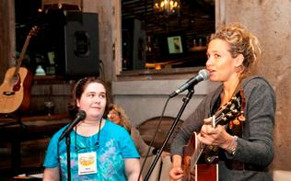
Recognize moments of opportunity.
Notes:
Recognize moments of opportunity. One focus group participant mentions that a new friend from an art class stopped by the house when Diane was sick. Since that relationship seems to be growing, perhaps staff can ask the friend, “Oh hey, would you mind picking up Diane this week?” At the same time, they could suggest to Diane to save her money so she can invite her friend to go out to coffee after art class another time.
Instead of looking to the recreation staff when the person with a disability needs assistance, look to another participant and say, “James, you seem to have that step down. Can you show Parker?” On the flip side, notice what the person with a disability can do to help other people. Suggest that they offer to help.

Slide 93
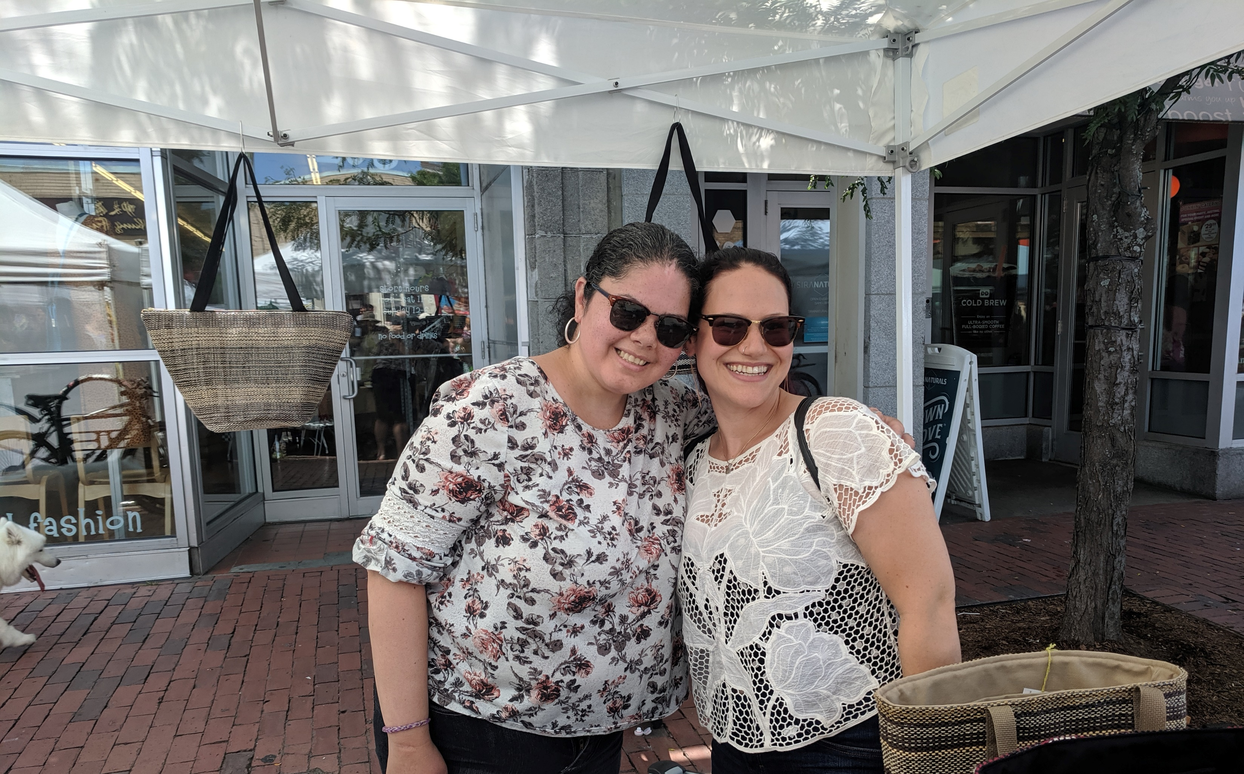
Invite to do something fun outside of the program.
Notes:
Invite to do something fun outside of the program. See if the person would like to go do something they have in common. You might need to do a little research at home with the person with a disability. Perhaps someone is wearing a Beatles T-shirt, and you find out there’s a Beatles cover band playing this weekend. Have the person with a disability invite them to come check it out. Maybe as the hiking group starts to take a break for the winter, suggest trying snowshoeing together. In a painting class, invite a potential friend to an art exhibit at the local museum. Libraries in Massachusetts often have discounted passes for museums and other venues. The internal culture of the group can guide what you suggest.

Slide 94
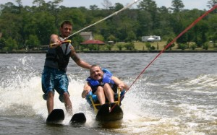
Help recognize balance in relationships.
Notes:
Ideally, friendships reach a kind of balance in responsibility for maintaining the relationship. For people who haven’t had a lot of experience with the give and take of relationships, this may need to be taught directly and the balance made explicit. We see this sometimes when people meet a new friend and call multiple times a day or week, leaving the other person overwhelmed and less interested in continuing the relationship. This can speak to just how lonely someone has been and how much they want to connect. To keep things positive, that balance needs to be made explicit. This also happens with social media. Also, if you catch someone at a bad time, it’s not that they don’t like you. Sometimes people are busy. Not everyone wants a hug all the time, so make a habit of asking first and being OK with no.

Slide 95
When it comes to friendships,
we believe that everyone needs friends now
and
do not need to be “ready” to make friends!

Slide 96
We said at the beginning that everyone needs friends…and you can be the one that helps it happen!
Notes:
You are a bridge-builder for friendships!

Slide 97

Resources
Chenine Peloquin, author of the toolkit:
chenine@playfulpelican.com
https://theplayfulpelican.wordpress.com/
Pathways to Friendship
The Arc of Massachusetts
https://thearcofmass.org/friendship

