Slide 1

WIDENING THE CIRCLE Pathways to Friendship Expanding opportunities for friendships between people with and without disabilities (A Partnership Between the MA Department of Developmental Services and The Arc of Massachusetts)
MAKING FRIENDS
WHERE YOU LIVE
Building
Friendships Between People
With and Without Disabilities
Prepared by Widening The Circle; Pathways to Friendship, a partnership between The Arc of Massachusetts and Massachusetts Department of Developmental Services
Follow us on Facebook and Social Media #PathwaystoFriendship
Notes:
Welcome group.
Briefly describe that Widening the Circle is dedicated to promoting friendships between people with and without disabilities.
Acknowledge that Widening the Circle is aligned with DDS’ Creating Our Common Wealth initiative.
Facilitator Tip: When welcoming the group facilitator should confirm what living situation(s) the audience may work in (group home, shared living, individual supports, family's home). This will help the facilitator know where to focus their examples to best benefit audience.

Slide 2
PURPOSES OF THE CLASS
To understand the importance of meaningful community connections and roles for people with disabilities and how these may lead to friendships with people who are unpaid, unrelated and who do not also have disabilities
To understand the negative impacts of isolation
To learn and share strategies that can help make these connections wherever someone may live
To demonstrate that friendships between people with and without disabilities can happen no matter where someone may live
Plan to put these discoveries into ACTion!
Notes:
PURPOSES OF THE CLASS
State purposes; but also reflect on times we’ve all experienced isolation and loneliness (2020 CoronaVirus pandemic) Draw from shared experience to have audience reflect on if their world was always to be so narrow.

Slide 3
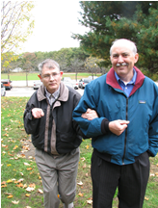
What Does “Friend” Mean To You?
Reciprocal
Freely given
Honesty- trusting/loyalty
Grows over time
Notes:
Facilitator Note: These next 2 segments (“What Does Friend Mean…”, “What are the Benefits of Friendships”, can be presented in a couple of ways, depending on class size and time limits. You can conduct each segment as a large group activity, identifying a writer to transcribe on wall paper the answers given by other members of the class. An effective alternative is to split the class into 3 groups, assign each group one of the questions, then have each group report their thoughts back to the larger group and invite the larger group to add/comment.
Ask people what words or phrases come to mind when they think of what “Friend” or “Friendship” means to them. List these on the sheet of wallpaper that you already prepared. After listing the participants responses compare it to the list below to be sure that you have captured key points:
Freely Given
Reciprocal
Honesty
Grows over time
Grow with Practice
Tendency to desire what is best for the other
Sympathy/ Empathy
Mutual understanding and compassion, “Friends ‘get’ you!”
Enjoyment of company, Affection
Ability to be ones’ self and express ones’ feelings
Make mistakes without fear of judgment
Trust & Loyalty
Bond born of similar (or at least compatible) interests and values
Be sure to emphasize the words/phrases shown on the slide. These are critical elements of real friendships. “Freely Given” (unpaid/uncompensated by money/grades/course credit, etc) may generate a lot of discussion, especially if the audience is primarily paid staff with long time, close relationships with people they support.

Slide 4
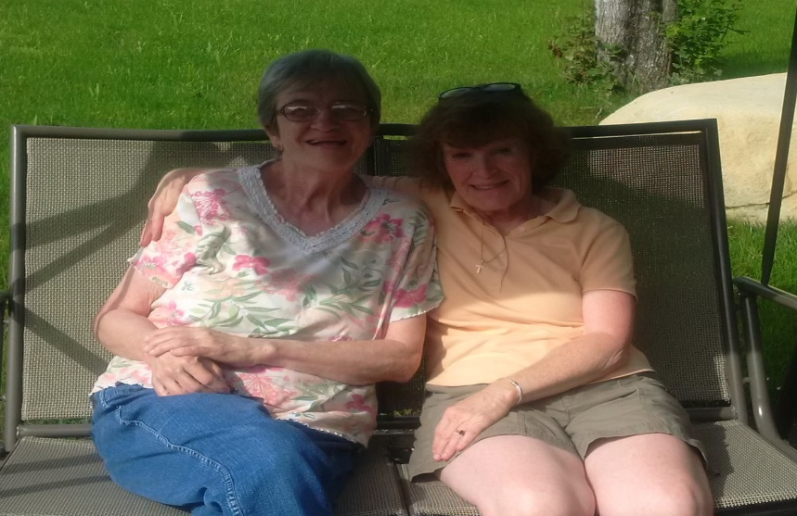
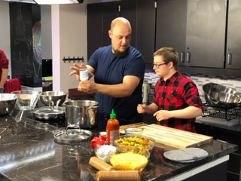
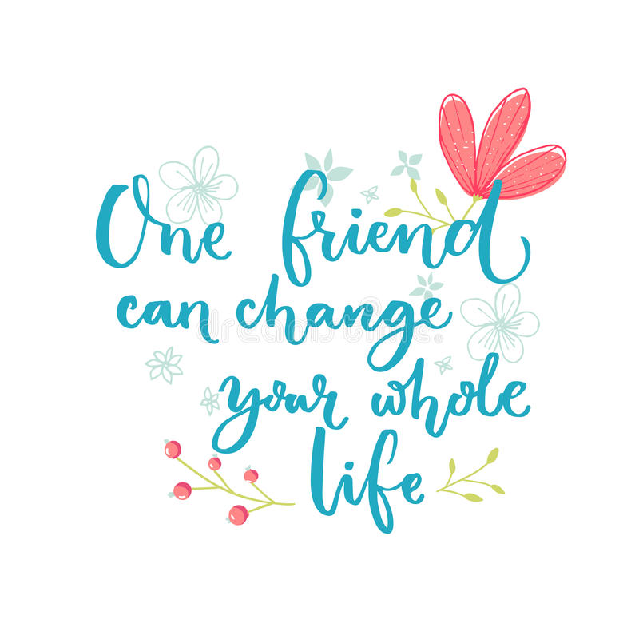
Friendship
Beyond staff…. Beyond family….. Beyond only other people who experience disabilities…. Beyond the screen…
Notes:
Use this slide to discuss how although family, paid staff, and friendship with other people who experience disabilities are important roles in everyone’s life- there are inherent limitations in these being the only relationship in ones life. The relationships we are creating are far more rare however can widen someone's circle immensely and create a richer life.
Exercises here for Trainer to explore or can use these questions and answers:
 “I TOTALLY “GET” THE PERSON FOR WHOM I PROVIDE SUPPORT HE CALLS ME HIS FRIEND. CAN’T
STAFF BE FRIENDS?”
The relationships between staff and the people they support are very important. Staff support is invaluable in
helping people with many of their needs. These are functional relationships—the individual has a specific need
for support and staff are assigned to fulfill that need. Good staff develop trusting and respectful relationships with
the people they serve, they get to know the person well, and commit to this role for extended periods of time.
Direct support staff are often very caring and express this care in ways similar to that of frien ds. However, these
are paid relationships. If a staff member gets a new job or is assigned a different role or shift, they may end their
involvement with a particular person. Friendships are unpaid relationships. If a former staff person continues a
relationship with someone they used to support, this can become a good friendship.
 “WHAT ABOUT FAMILY MEMBERS, ESPECIALLY SIBLINGS? THEY MIGHT KNOW A PERSON FOR THEIR
ENTIRE LIFE. AREN’T THESE FRIENDSHIPS?
Family relationships are important to all of us. Some of us have very close relationships, particularly with certain
family members. We may see each other frequently or be in touch through phone calls, emails, Facebook, letters,
occasional visits, shared activities, and so forth. Other family relationships may be more distant—with either
limited contact or none at all. Some people may consider a close family member their “best friend.” However, we
typically think of friends as people who know and care about us who are not part of our families. Sometimes we
think of our friends as “chosen family.”
 “THE PERSON I SUPPORT HAS LOTS OF FRIENDS. WHEN WE GO TO THE GROCERY STORE AND THE
YMCA EVERYONE SAYS ‘HELLO’ TO HIM.”
It sounds like he is known to many people and has a lot of acquaintances. This is a good beginning for building
friendships and is the first component—proximity. Does he get to see anyone outside of these two settings? Do
any of these people visit him or invite him to do an activity together? Does he know how to connect with them—
by phone or email or social media—perhaps to extend his own invitations to others? Taking the next steps can
move an acquaintance relationship to friendship.

Slide 5
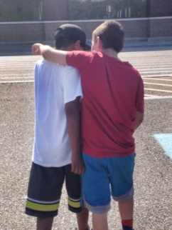
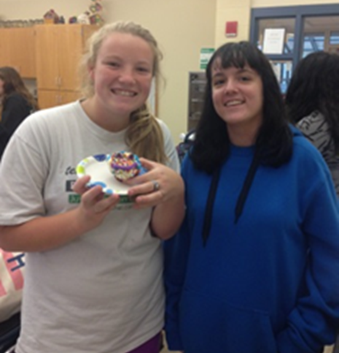
What are the Benefits of Friendships?
Friendships are critical to our quality of life…
People with friends are:
HAPPIER
HEALTHIER
SAFER
"Friendship improves happiness,
and abates
misery, by doubling our joys,
and dividing our grief."
MARCUS TULLIUS CICERO
Notes:
Ask participants to “shout out” benefits of friendships. (Depending on your audience, you may want to concentrate on a specific age-group for this activity.) List these on the sheet of wallpaper that you already prepared. After listing the participants responses compare it to the list below to be sure that you have captured key points:
Benefits for KIDS
1. Reduces instances of BULLYING
Benefits for TRANSITION-AGED YOUTH
1. Friendships might lead to a job!
2. Can lead to deep, intimate relationships.
C. Benefits for ADULTS
1. Friendships might lead to a job!
2. Can lead to deep, intimate relationships, including marriage.
D. Benefits for ALL AGE GROUPS
1. Happier: increased happiness, sense of self-worth
2. Healthier: better emotional and physical health. (Loneliness kills!)
3. Safer: providing safeguards against abuse & neglect happening and prompt recognition if abuse & neglect does occur.
4. increased social skills.
5. a sense of belonging and acceptance; someone to be yourself with.
6. more confidence.
7. more support, someone to depend on, someone to trust.
8. reduced isolation and the negative effects associated with it.
9. creation of a variety of other opportunities in peoples’ lives.
10. Gives purpose to skill training already in progress with people. (meaning, for example, I have been learning a lot about cooking but it makes it all the better that I can cook
for a friend I invite over to dinner.)
11. Learning—by both parties—from role-modeling by the other!
12. stronger communities.
13. more inclusive societies; enriches everyone’s lives.
14. better connected families.
E. Friendships between peers with and without disabilities can result in additional beneficial outcomes that include:
1. a greater understanding and appreciation of individual differences by the “typical” peers
2. development of age-appropriate social skills
3. expanded friendship networks
4. improved quality of life for both participants

Slide 6
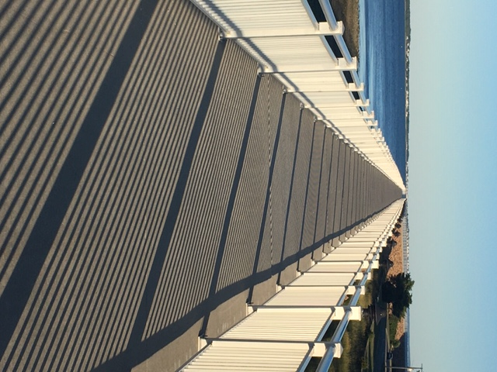
We can’t overestimate how important it is to support people in developing friendships. We are all responsible to support these pathways to friendships!
Manage our fears/risks?
How do we move forward?
Rejection
Hurt
Failure
Vulnerability
……….We must build bridges together
Notes:
Emphasize that the audience are The Bridge Builders- The Connectors- Trainer Reference for Supplemental Information
“A Tale of Two Bridges” By Jack Yates
Briefly touch on Fears of Rejection, Hurt, Failure, Vulnerabilities…These are universal to all living arrangements- Reference Dignity of risk and creating safeguards that support relationships… what do they need; relationships are prioritized and then the physical and support needs become part of supporting the how while not compromising the goal of friendship.

Slide 7
Exploring the Strategies
Know the person you support well.
What are their hopes?
What are their dreams?
What is their life vision?
What they are passionate about?
What brings out the best in them?
Who might they become?
What gift do they bring to our world?
Notes:
Facilitator Tip: You may want to preface this section to include an acknowledgement that some strategies may be better suited to some living situations than others.
Facilitator then will phrase questions rhetorically to audience at first but then choose one or two questions upon which to invite reflection. Audience may take a minute to write and answer a question about a person they know. Invite sharing for discussion.

Slide 8
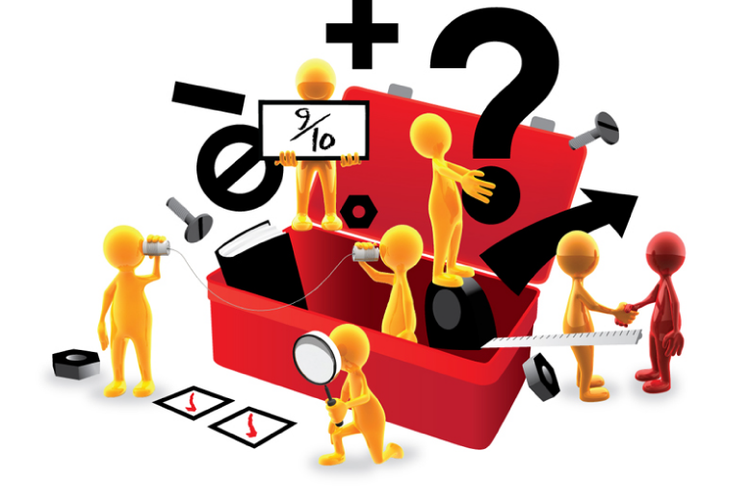
Tools
Community Interest Survey
http://thearcofmass.org/vinfensurvey/
Person Centered Planning
(https://rtc.umn.edu/docs/pcpmanual1.pdf)
http://mn.gov/mnddc//extra/publications/choice/Its_My_Choice.pdf
https://www.lifecoursetools.com/lifecourse-library/foundational-tools/person-centered/
Creating a Circle of Support
https://www.ric.org.au/learn-about/building-support-networks/circles-of-support/
http://www.imaginebetter.co.nz/building-my-tribe-circles-of-support/
Notes:
Building a network deliberately around someone allows for varied perspectives and many people working to support these goals. Having a developed plan or tools to reference can support deliberate action to support valued roles to make connections that will lead to relationship and belonging in someone's life. Facilitator Ask Audience what process are people using now?

Slide 9
2. Know places in the community well:
Identify places of both formal and informal gathering
Identify places where the person will be accepted just the way they are
Know the people in the community well (connectors, welcomers, gatekeepers)
Notes:
Facilitator Ask participants what they do in community what are their interests. Gather list on Wall Paper or just draw connections between participants with commonalities. Highlight also that if staff, neighbors, board members, extended family/family friends start sharing connections and interests their may be a good opportunity to make a connection!

Slide 10
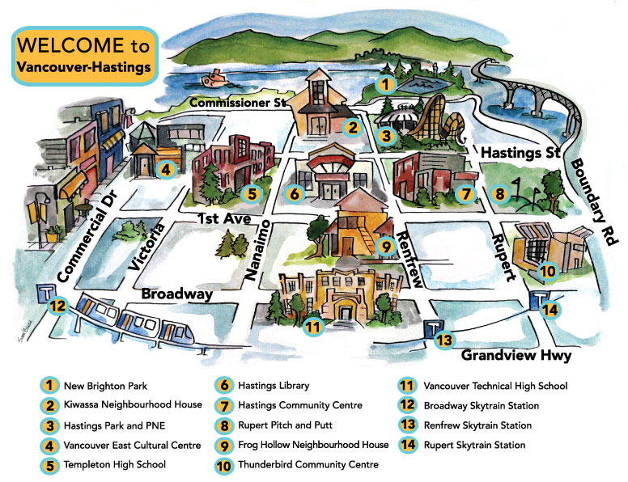
Community Mapping
Notes:
Every neighborhood has its unique gifts… the best café for coffee, the park where everyone walks their dogs. Every community has dozens of organizations in which someone you support could become a member, a contributor, a regular. Think back to interests, dreams and passions of the people you support? Where in the community could they share these with others and build potential friendship?
If we aren’t deliberately looking we pass by these ordinary places that are full of community and gathering. Whenever we devote time to community discovery and mapping it’s a guarantee someone will say, “I never knew that was there!”
Involve your DSPs as well as people you support to explore the communities (Jack Yates provides a really nice training that incorporates this). Do that in both communities that may be new to your service network as well as communities in which you’ve been involved for a long time.
Pay special attention to places where can people become regulars.

Slide 11
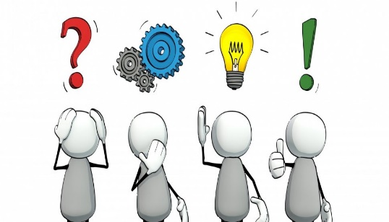
Who do we know? Where should we go?
Identify who the person already knows and where relationships might be fostered or deepened?
Background Map to record highlights of the personal life experience of the for us person and a look this or her family life and community life. This informs us o f major events and influences that impact the person including medical events, moves, births, deaths, beginnings and endings of work or school, transitions and other life changes.
Relationship (People) Map People maps can help identify places where relationships can be built and people with whom relationships can be deepened.
Notes:
Emphasize that the background map can recall relationships forgotten or overlooked. Social Media can be a great tool to reconnect with old classmates, neighbors, coworkers etc.
Facilitator can have the participants create a relationship map- The circle around this person includes those who closest to him or her, often family and those with whom there is a close bond. The second circle includes those who are seen on a regular basis and
are considered friends. The third circle is for those that the individual sees through shared activities and
finds meaningful in some way but with whom there has not been much opportunity for deeper contact.
The outer circle might include acquaintances and persons seen for some form of exchange. The map
might be broken down into sectors of “Family,” “Friends,” “Neighbors,” “Service Providers,” and
connections through work, school, volunteer or community activity/civic group affiliations and others.
Facilitator can have audience do for one person and have participants reflect on how they could deepen and broaden these circles or Facilitator can have participants do a circle of their own life and then of someone they support- reflect on differences and then ask again… how to enhance the circle of the person you support?

Slide 12
3. Make person to person connections
Be thoughtful about who might appreciate getting to know the person
Consider who in the community might be seeking out a relationship with the person you support
Identify persons who might be enlisted as community connectors
Notes:
Ask the group “Who are the people in your community who are already members of the places that the people you support may have an interest in that you just shouted out? -who here belongs to what associations, organizations, etc.
-who knows other, trusted individuals who belong to place that the people you support are interested in.
Reference others in Roles- “Who knows a Gardener, an Artist, a musician, a crafter, a DJ, a yogi??” Could you introduce them to someone you support to help them to share an interest and also become a Gardener, an Artist, a musician, a crafter, a DJ, a yogi?
Be thoughtful about The Invitation to Engagement; The right person, asked the right question, at the right time will become a match!
Reference Full Day Training “The Ask; Invitation to Engagement.” as a possible future training opportunity.

Slide 13
Presence, People, and Persistence
People must be physically present with other community members and engaged in the same activities IN THE COMMUNITY
Community is not about a physical place, its about the people
This implies avoiding “special” groups and spaces because those in fact are segregated
Notes:
Emphasize that community is about people- it is not an abstract “outing” where you interact with no one other than paid staff. To be truly OF the community you share traditions, spaces, and rituals with other members of the community.

Slide 14
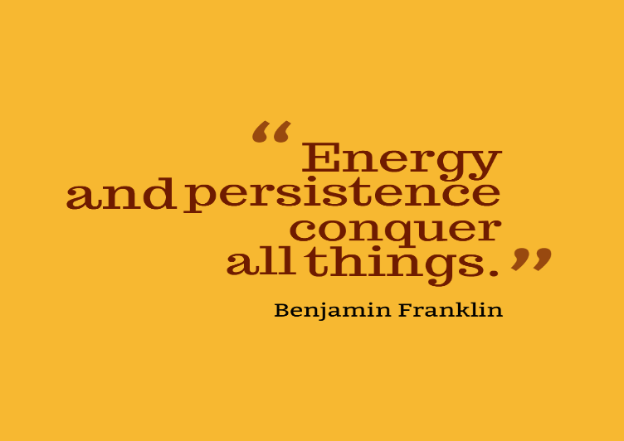
“If at first you don’t succeed”
Relationships take time
Become a regular and create strong routines
Be typical and prepared to “fit in” to the environment you are in
Notes:
Sharing in the same patterns regularly builds relationship potential. Studies indicate that it takes on average 30 hours of time with someone before you even consider them an acquaintance. Encourage the audience to “Study the Ordinary.” Breakouts can be done in small groups to ask people to explore how did they go from neighbor to friend etc…. The little steps along the way that occur need to be studied in order to effectively support another's relationship to develop.

Slide 15
Relationships and friendships can be found wherever we Live, Learn, Work, and Play
Develop social skills
Be a good neighbor
Practice reciprocity
“150 Things You can do to build community”
https://sites.hks.harvard.edu/saguaro/whatyoucando.html
Notes:
Everyone Needs Friends now, so there is no social test to pass however keeping your eye on the opportunities to initiate friendliness and good manners can go a long way in developing or deepening a relationship. Looking the part and preparing for each setting can have outcomes in better connecting. Knowing how to look and what to bring for every occasion sets the stage for others to be more welcoming.

Slide 16
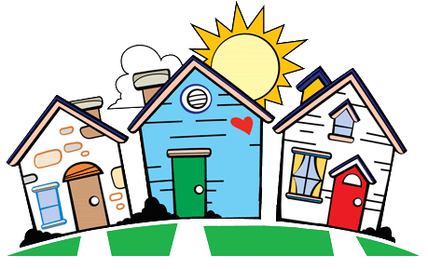

Hospitality
A welcoming appearance
Welcoming furnishings
Welcoming habits
Notes:
Facilitator to invite the audience to brainstorm how they are or could be achieving the bullets as noted. Examples to reference and pull from below.
Specific ideas to come under "hospitality":
A welcoming appearance
- Do what you can to make your home match the neighborhood
- Keep the front yard spotlessly well manicured
- Grow a garden, flowers and vegetables
- Decorate for holidays as your neighbors do, or just a bit nicer
- Try not to have too many cars parked in front
- Clearly marked house number so new friends can find you
- Keep up repairs, painting, shingles, etc.
- Well-lit walk and entrance
- Welcome mat
Welcoming furnishings
- A fireplace, with a fire going in it for guests
- Patio chairs, outdoor table, outdoor grill, pool-- what can you invite guests to do, indoors and out?
- Front porch chairs, to welcome passers-by
- Chairs indoors arranged for conversation, more than for television
- Pictures, photograph albums and other invitations to conversation in the living rooms
Welcoming habits
- Keep the television off, especially turn it off the moment anyone comes to visit
- Available board games
- Coffee and tea and snacks ready to serve
- Nice china and serving platters for guests
- Hosting gatherings for holidays, sporting events, special broadcasts, election night, etc.
- Sharing baked good, garden produce, flowers with neighbors
- Bring them next door on a good late, so the neighbors will have to return it to you

Slide 17
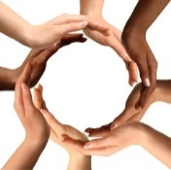
MAXIMIZING MEANINGFUL COMMUNITY CONNECTIONS
Instructions: Briefly write what, if anything, could be done in each situation to enhance the chances of developing relationships within your neighborhood/community.
___Going to a Block Party.
___Volunteering.
___Having a cookout with family and friends.
___Organizing a yard sale. ___ Going for daily walks in the neighborhood.
Notes:
Staff are already busy. So how can we get our regular work done & help people connect in the community in the limited time we have? We have to be smart about the time we have. Facilitator should include an admonition that everyone have opportunities no matter where they live or how they're supported or any “level” or type of disability.
MAXIMIZING COMMUNITY CONNECTIONS: Pair up the participants and ask them to spend a few minutes ranking the list on the screen (Substitute some places that pop up in discussion on Slide #7 above) and follow the instructions. Then, as a large group, lead discussion, concentrating on how each activity could be improved to enhance the chances of connections/friendships. And remember, we want to make sure that everyone--no matter their level of disability—have opportunities!

Slide 18
10 THINGS THAT EVERYONE CAN DO TO PROMOTE FRIENDSHIPS
1. Create Membership—at school, work, and in the community
2. Identify Relationships you already have that can be deepened or
that can connect you to new people and activities
3. Identify and Share your family member’s Gifts and Interests
4. Identify Places where people with similar interests regularly
gather
5. Identify Environments and supports that allow your child/someone you support to shine
6. Find “Bridge makers”—people who can connect your child/someone you support to others
7. Teach Others what they need to know about your family member/someone you support
8. Emphasize Similarities and Gifts
9. Invite People into your life and home or those of someone you support
10. Use Your IEP, ITP, ISP
Notes:
Reference Robin Harmatz- ISP and Friendship
Emphasize connections are built in the strategies- not in separate Friendship Goals.
This is referenced in toolkit as a list for Family members but could be handout for broader audience.

Slide 19
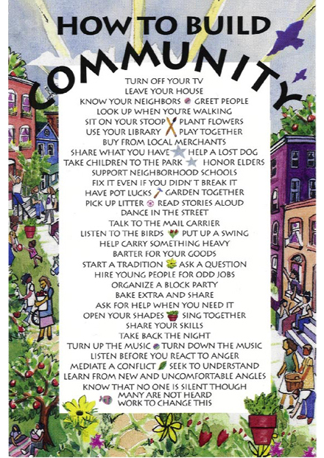
Commit to ACTion!
Notes:
Send audience off with a charge to think of the next reasonable step that they can take in their already busy lives to ensure that people have more chances for meaningful connections in their communities and opportunities to form friendships. List is provided as a reference to choose one if they haven’t another strategy they’ve already chosen.

Slide 20
We must delight in each other, make others conditions our own, rejoice together, mourn together, labor and suffer together, always having before our eyes our commission and community in the work, our community as members of the same body.
JOHN WINTHROP
Notes:
Quotation is from the speech at founding of the Commonwealth in 1630. A nice way to close and thank your audience for their commitment to build a stronger community, one person at a time.

