Slide 1


Friendship at Work:
Creating Connections to Ensure Success
The Arc of Massachusetts
in Partnership with the
Dept. of Developmental Services
Extensively Referenced:
Building Friendships at Work
A Toolkit for Employment Specialists,
Job Developers and Job Coaches
Notes:
Welcome group- Intro self
Ask for people to write the organization they work for and their role there

Slide 2
Building Friendships at Work:
A Toolkit for Employment Specialists, Job Developers and Job Coaches
To download a free copy of the referenced toolkit, visit: https://thearcofmass.org/friendship
This toolkit is authored by Richard Hawes, Director of Employment Services; Berkshire County Arc.
With contributions from Jim Ross and Mary Ann Brennen; Widening the Circle/Pathways to Friendship.
This PowerPoint presentation was developed by Phoebe Goodman; Widening the Circle/Pathways to Friendship
Notes:
I wanted to note that the toolkit that is heavily referenced in this presentation is free to download on the Arc of Mass website

Slide 3
Objectives
Importance of Friendship
Why is Work Essential?
Supporting Friendships at Work
Vocational Assessments
Natural Supports- Work Buddy
Continuing Friendships Outside of Work
Career Planning
Person-Centered Planning
Q&A
Notes:
During this webinar, we will review: (read slide)

Slide 4
What does it mean to be friends?
We have chemistry! We enjoy each other’s company. We trust, understand, respect and appreciate each other. We like how we feel when we’re together. We are close even when we are apart. We look forward to being together. We commit over some time. We give to each other. We may not give in the same way but what we give and what we receive is of great value to each of us.
Everyone needs friends.
People with friends are happier, healthier, and safer.
Notes:
So how do we define what friendship is? (Read)
(after Safety explain: When people have friends, they are safer. It’s more caring eyes-on the person, someone to wonder where they are if they aren’t at their weekly yoga class, or art group, or workplace, community members that have connected and care about the person.

Slide 5


Why are friendships essential?
Despite decades of great advancements in disability rights and efforts at inclusion, we still have lots of inaccessible communities, substantially separate educational opportunities, group homes, sheltered work, etc.
Notes:
(Read Slide) There are still so many ways in which people with disabilities are segregated and not given opportunities to truly connect with others in their communities.

Slide 6

Why is Employment Essential?
What is one of the first questions people ask when introducing oneself?
  What do you do?
What would you miss most if you were unemployed?
  Money
  Social Interactions
  Schedule
  Something to look forward to
  Sense of pride and accomplishment
  Social Interactions
Notes:
Why is employment essential? The first question people ask often is: What do you? A big questions, implying what one does for work.
If you were unemployed, what would you miss most? For some it would be the money but for many losing the social aspects of working would be the hardest thing to miss out on. There’s something really nice about working with people you like, even just having that one or two work buddies to catch up with over breaks and lunch. Those friendships can blossom outside of work into friendships. I’m sure many of you have friends that you met at work over the years.

Slide 7

How does unemployment affect wellness?
Notes:
Being unemployed can affect people in many health-related ways, I’m going to go over why being employed is so significant, not only for one’s physical health but also affects people in numerous other ways.

Slide 8

Physical Health Consequences of Unemployment
Unemployed people are more likely to have poor health habits:
- Excess drinking and eating
- Smoking
- Lack of Exercise/Sedentary Lifestyle
Unemployment was strongly linked to long-term mortality
(Robert Leahy, Ph.D.)
Notes:
Read

Slide 9
“Long-term unemployment is associated with a decline in social networks and frequency of social connections.
Unemployed individuals are less likely than others to engage in civic groups and other types of community action.”
-T. Araten-Bergman and M.A. Stein
Notes:
Read Slide

Slide 10
Positive Non-Vocational Impact of Employment for People with Disabilities
Improved Mental Health
Improved self-esteem
Improved quality of life
Improved social functioning
Reduced hospitalizations
Positive perception of well-being & self-efficacy
Reduce Poverty
Notes:
It has been found that there are so many other ways that being gainfully employed positively affects one’s life—
Read Slide

Slide 11
Employment Represents…
Desirable social role
Affirmation of his or her own identity
A symbol of 'normal’ functioning and ability
“People may perceive themselves as “able” which may lead to improved feelings of self-efficacy and self-determination… this enhances social and civic interactions with others.”
-T. Araten and M.A. Stein
Notes:
Read Slide

Slide 12

    “Competitive employment may be associated with greater improvement over time in symptom control, quality of life, self-esteem, and social functioning, compared with no employment.”
    (Supported Employment: Assessing the Evidence)
Notes:
It was found in a study about supported employment that: (read slide)

Slide 13

“Gainful employment provides individuals with financial resources needed for participating in community events and social activities…”
Notes:
Read Quote on slide- When you have money, you have more opportunities to participate in activities that could potentially connect you to new relationships..

Slide 14
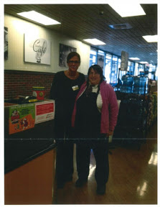
Supporting Friendship at Work
Notes:
Now that we’ve reviewed the basics of why being employed AND having friends is important, we’ll dive into supporting Friendship at work.

Slide 15
What tools are available to help develop a good career plan that assists in facilitating relationships in the workplace?
Notes:
There are many tools available to support employment staff facilitate relationships in the workplace. It starts with thoughtful planning.

Slide 16
Person-Centered Career Planning
  Utilizing Person-Centered Career Planning (PCP) and building a
  “Personal Profile” are effective ways to capture lots of information about the individual that can be useful in creating a good match between the individual and a job in the community.
  These tools probe at issues relevant to the possibilities of relationships in the workplace.
Notes:
Read Slide

Slide 17
Person-Centered Career Planning
Assessments typically include, but are not limited to:
Preferred work environment
Type of work tasks the individual is capable of handling
The type of work the individual is interested in doing
The schedule the individual can work
Available transportation
Level of supervision required
Notes:
Read Slide
Person-centered planning may also involve a relationship map (next slide)

Slide 18
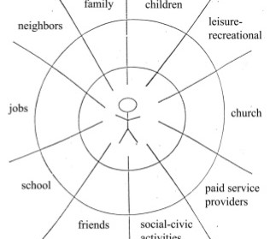
Relationship Map
Notes:
A map might look like this, categorizing the people that the individual already has in their network. (next slide)

Slide 19
Relationship Mapping
Who is in their network?
Where are they connected already?
What are the main patterns and themes in the individual’s relationship network?
What areas of relationship are missing? What would be important to build?
Are there old friends or acquaintances from the past, with whom the focus person would want to reconnect?
Are there friends or acquaintances from the community that can be invited to join the planning circle?
Where could community members who would like to get to know this person be found?
Notes:
The purpose of a relationship map is to determine: (read)
After some basic P-C-P, we move into the vocational side of supporting people develop friendship at the workplace. (next slide)

Slide 20

Thorough Vocational Assessments
Notes:
Many, if not all of you, may be familiar with what a vocational assessment may entail. However, it’s important to have some questions ask that focus on the social aspects of work during this assessment period. (next slide)

Slide 21
Individualized Vocational Assessment
Especially with new referrals, it is imperative to conduct an individualized person-centered assessment of the person’s strengths, needs, preferences, and capacity for employment.
This assessment should involve career preferences, interest inventories, background information (from a variety of sources including schools, family, funding sources) and real work experiences.
Notes:
Read Slide

Slide 22
Individualized Vocational Assessment
This assessment can range from 20-60 hours. Individuals with little or no work experience and/or with challenging issues may need longer assessment periods.
However, the most important part of this assessment process involves the employment staff really getting to know the individual and developing a positive relationship with that person.
This will facilitate a good job match and, in turn, higher likelihood of developing relationships in a new job.
Notes:
Read Slide
ASK: Who else should be involved during this assessment process? (next slide)

Slide 23

Career Planning Process
The planning process itself should not be limited to staff and the people supported. Family, friends, and other community resources should be invited to the table.
If the individual is served by another agency residentially, those people should also be involved. It is likely that a desirable job with the potential for friendships with co-workers will take coordinated efforts among multiple provider organizations.
Having the right people at the planning table ensures that the process pays attention to opportunities that will enhance the chances of good relationships-including friendships developing at work.
Notes:
Read Slide - first two paragraphs
I have found this to be very true- it requires coordination and cooperation between the home and day program to ensure success. This could mean working with one or more provider organizations to ensure the person is dressed for their interview, or has food packed for their shift, or that transportation is arranged.
Read last paragraph (next slide)

Slide 24

Career Planning Process
The individual must be actively involved in determining aspects of planning this meeting. (i.e., where/when it should be held, who should be invited, etc.) The individual must be the focus of the discussion, with questions being directed towards that person. Participants should not be talking about the person, but directly to them.
Creating an action plan to assist the individual securing employment that involves the people attending the meeting is really helpful (i.e., someone using their network to contact an employer, residential staff ensuring they can support transportation, etc.)
Notes:
Read Slide

Slide 25
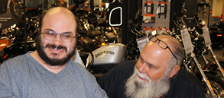
Joe’s Story
Notes:
Joe acquired a severe head injury at the age of 14 when he was in motor cross race and crashed his motorcycle leaving him in a wheelchair and having to start the long road to recovery.
Joe was referred for employment services when he turned 22. After completing a vocational assessment, employment staff conducted the person-centered-planning process with Joe and his team.
Joe was emphatic about getting a job in the motorcycle business. The team, despite having some concerns, they honored his passion and began looking for work in desired career.
After contacting the local motorcycle shops, as well as local auto shops in the area, one successful company, Ronnie’s Cycle Shop, knew Joe’s history. After much discussion between Joe, his team, and Ronnie’s, they carved out a part time job.
Joe does a myriad of duties including detailing the motorcycles, assisting with inventory, and packaging the products. He loves his job and they love him.
From cups of coffee in the morning with coworkers, to attending work functions, to assisting a fundraising annual event, Joe has become part of Ronnie’s family for the past 11 years.

Slide 26

Job Development and Relationships
Job Developers already have a complex job. They need to:
Explore the local community to be thoroughly familiar with job opportunities.
Develop positive relationships with businesses and business groups (i.e., chamber of commerce, local collaboratives, etc)
Be good “sales people”- Be able to convince employers that the people you support can meet their business needs, convince family members of the benefits of working in the community, and often convince the individuals that they are deserving and capable of real jobs alongside other community members.
Notes:
Read Slide

Slide 27
Setting & Workplace Culture
How can employment staff secure jobs that can facilitate the development of relationships in the workplace?
Culture is the character and personality of your organization. It's what makes your organization unique and is the sum of its values, traditions, beliefs, interactions, behaviors, and attitudes.
Focus on the type of setting and culture of a workplace as defined by HR Insights as:
Notes:
How can employment staff secure jobs that can facilitate the development of relationships in the workplace?
It’s important to focus on the type of setting and the culture of a workplace. Culture is defined by HR insights as: Read Slide

Slide 28
For example, in work settings or cultures that have progressive management, and lower turnover of staff, there is greater stability and a higher likelihood that an individual will develop relationships in that business.
Good job developers will “do their homework” and identify those businesses that have cultures and settings that match the individual's social needs and preferences.
Good job developers match the job to the individual, not the individual to the job.
Additionally, it is far easier to develop relationships in a work culture when the employee is in an individual placement, on company payroll, and a part of the daily routines/structure of the business.
Notes:
Read 1: ADD-- Progressive culture: (i.e. have experience and inclusive philosophy with employees with disabilities)
-business has a diversity page on their website, etc.
Read 2: Social needs and preferences. Taking into consideration things like, would the job seeker prefer a place where there is a lot of opportunity for social interaction, or would a workplace with less social time preferred. Does the person prefer a lot of supervisory support, or are the more of an independent worker?
As you all know…Read 3
Read 4: It’s easier to support one person at a workplace in developing friendships than it is to support multiple people at a job site

Slide 29
It is during this initial process that a job developer/employment staff assesses all factors to a good job match that can lead to developing relationships at work.
The following factors should be included when conducting a job analysis/assessment to determine if the job is a good match for the individual:
Core and episodic work routines (i.e. are there intersecting or overlapping tasks with other employees?)
Scope and type of orientation and initial training of coworkers/company staff (is there a company orientation for all new staff?)
Availability and willingness of coworkers to assist in work related matters (is there an unwritten lead employee in the business/department that others go to for assistance)
Unwritten rules unique to the work setting (i.e. casual Fridays)
Work site culture of productivity, quality, and social interactions.
Notes:
Read Slide

Slide 30

Facilitating Relationship Development
It is easier for friendships to develop if positive relationships amongst co-workers are nurtured and supported from the start. There are several things that the Job Coach should do to facilitate developing relationships.
Job Analysis when someone begins to work, or even prior to starting their job, should be done in order to understand the workplace.
Notes:
Read Slide

Slide 31
Job Analysis
Prior to the individual starting at work (or ASAP when the person starts), the job coach should spend time in the business doing more detailed job analysis. This is in order to not only learn the job routines but also being able to “read” specific aspects of the workplace culture including but not limited to:
    Appropriate attire, including any “special days” (i.e. casual Friday, daily uniform).
    The flow of the daily schedule/work routines/overlapping duties
    Food and drink routine
    Where people gather at breaks/before work
    Key coworkers/supervisors for orientation and training
Notes:
Read Slide
Repeating the assessment that the employment staff developed, finding out the real day to day details of those factors, (read again quickly)

Slide 32
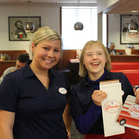
Natural Supports
After the job analysis is done, the job coach and employment team should develop a training plan that incorporates as much natural supports as possible.
Transportation: secure and facilitate transportation that’s as typical as possible, including the possibility of carpooling with new co-workers
Orientation: coordinate with the employer how the individual will be oriented and trained. Try to get the employer to commence doing this on day one. Have individual be oriented just like every other employee.
Training: utilize current employees whenever possible to help the person you support understand job tasks and culture (i.e. have supervisor or co-worker show individuals how to clock in/out)
Rachel is a Memory Maker at Friendly’s in Pembroke. She helps with many restaurant’s operation’s responsibilities.
Notes:
Read Slide

Slide 33
Natural Supports (continued)
Interactions: Facilitate and encourage interaction between the person you support and their co-workers at breaks, lunch, and work time. Encourage him/her to take breaks or lunch at the same time as their coworkers, if possible.
Fading: Utilize as many natural supports as possible! The less the person you’re supporting needs YOU, the better!
Relationships: Teach or show the individual how to greet people (i.e. saying hello in Spanish, making eye contact, introducing themselves to coworkers), how to make small talk at breaks and finding commonalities with coworkers (i.e. sports, art, music).
Notes:
Read Slide

Slide 34

Natural Supports
Natural Supports: Coworkers who might be able to assist in the training of a new person, or provide ongoing help, as needed.
If the individual is without a job coach, who can they ask with questions?
Is there a coworker who does a similar job to the individual and might be a natural support?
Is there a coworker who is very friendly towards the person you’re supporting at their job? Could you engage them in a conversation about befriending him/her?
Notes:
Read Slide

Slide 35

“Work Buddy”
Identify a “work buddy” - a co-worker who understands the individual and agrees to kindly point out when the individual does/says anything that may interfere with inclusion.
Determine overlapping or intersecting tasks
Act as consultant and help solve problems with the employer rather than doing it yourself
Facilitating relationships- introducing him/her to other coworkers, encouraging the individual to sit with them at break, etc.
Notes:
Read Slide: Much in the same way YOU and I may try to find a Work Buddy when we start a new job, the person you’re supporting at work would want the same! I know that I have always looked for a coworker that I could go to, instead of my boss, with questions and to introduce me other colleagues

Slide 36
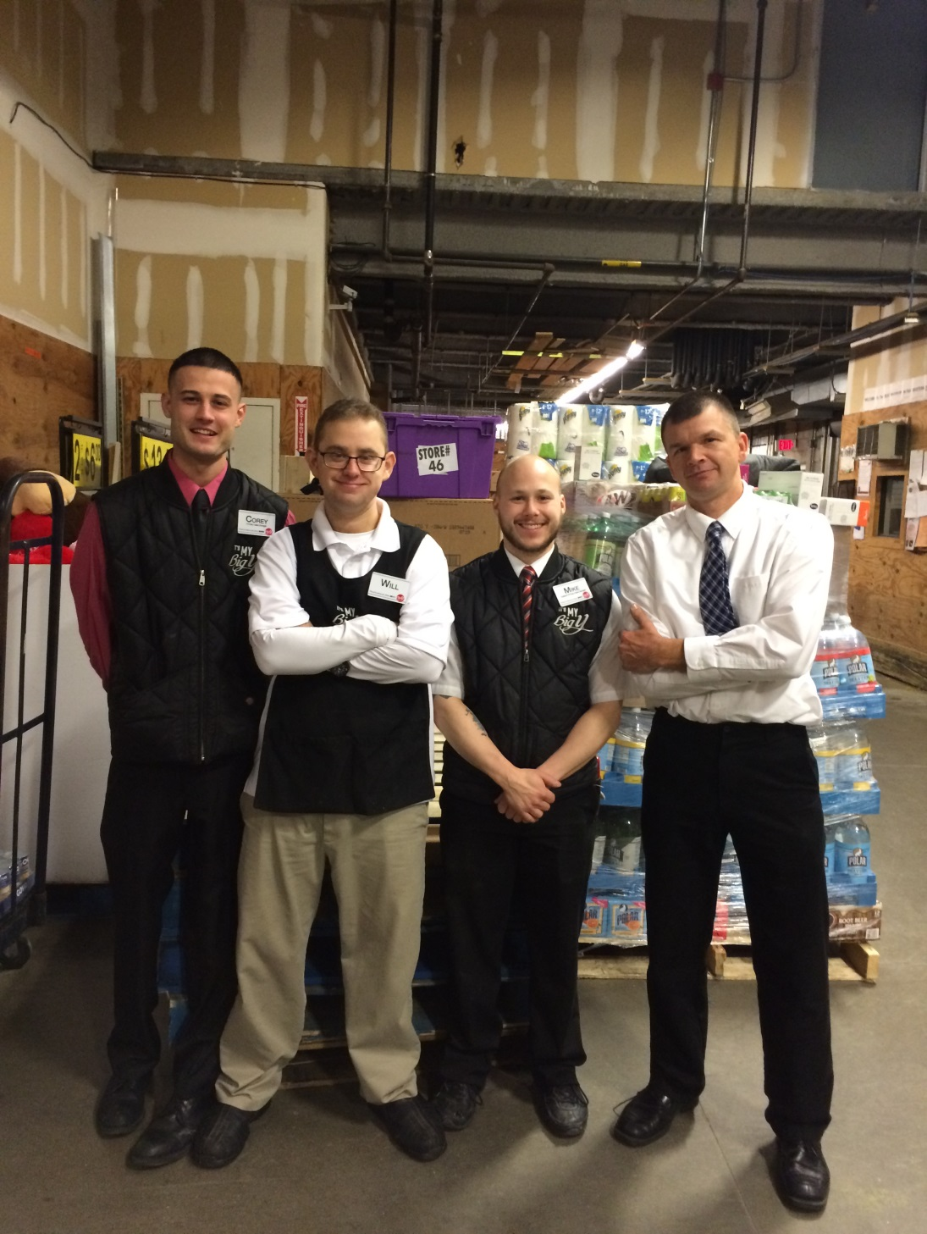
As a Job Coach, you may need to help the person you support:
  Stay focused and get the job done to the employer’s specifications.
  Speak wisely. Don’t gossip and talk badly about other workers.
  Set boundaries. The friendship with the boss should be different than the one with colleagues.
  Be mature. Everyone wants to believe they will never be involved in a workplace conflict, but it’s not realistic.
Notes:
Read Slide

Slide 37
Continuing Friendships Outside of Work
After a worker has established him or herself as a competent worker and after they have connected with one or more co-workers in a relationship, it is time to consider the “next step”. Ideally, relationships developed in the workplace have an impact beyond the worksite and workday.
“Reciprocity” is a key part of real friendships. Both people must be engaged and committed to the relationship, and both must get something positive from it. Friendships—like all relationships—require a bit of work. If the individual receives support from more than one organization, it will take some coordination to be successful.
Notes:
Read Slide

Slide 38
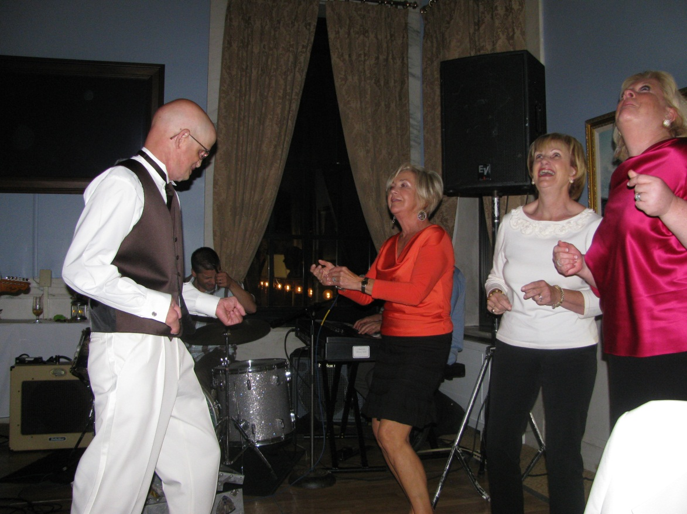
Continuing Friendships Outside of Work
Some things to consider:
Do co-workers occasionally or regularly gather somewhere after work (yoga class, local pub, etc)? How can you support the person you work with to be part of that without being intrusive?
Does the company have any sports teams (softball, bowling, etc.) or company events (holiday parties, etc) that the individual can be part of?
Notes:
Read Slide

Slide 39

Continuing Friendships Outside of Work
Is the company involved in any charitable activities (Walk for Hunger, Cancer Walk, Habitat for Humanity, United Way Day of Caring, etc) that the person you support can be part of?
Can you support the individual to initiate an activity to which he/she can invite his/her co-workers (potluck supper, Super Bowl party, birthday celebration, cookout, etc)?
Is there a way to encourage co-workers to consider inviting the individual you support to celebrate certain Holidays? (Thanksgiving, Labor Day BBQ, Hanukah, etc.)
Notes:
Read Slide

Slide 40

Remember, if an individual is considered a reliable employee and does their job well, the individual will gain respect from their coworkers.
Notes:
Read Slide

Slide 41

Questions

Slide 42

Be an Optimist & Be Persistent
Determining what a person can do versus what they cannot do is critical to the job development success.
If employment staff believe that the individual is capable of job success and developing relationships in the workplace, it becomes achievable!
Notes:
Leave you with this thought: (read slide)

Slide 43
For More Resources
https://thearcofmass.org/friendship

Slide 44
References
S. Azrin, Ph.D.: Improving Health and Reducing Premature Mortality in People with Severe Mental Illness; NIMH (2012)
T. Marshall et al. : Supported Employment: Assessing the Evidence (Psychiatryonline.org, Jan. 2014)
T. Araten-Bergman and M.A. Stein: Employment, social capital, and community participation among Israelis with disabilities (2014)
J. Evans: Employment, social inclusion and mental health (Journal of Psychiatric and Mental Health Nursing, 2000)
R. Leahy, Ph.D. : Unemployment is Bad for Your Health (Huffington Post, 2013)
G. Townley, H. Miller, B. Kloos: The impact of distal social support on community integration and recovery of individuals with psychiatric disabilities (2013)
Y. Griep, U. Kinnunen, J. Natti, N. De Cuyper, S. Mauno, A. Makikangas, H. De White: The effects of unemployment and perceived job insecurity: a comparison of their association with psychological and somatic complaints, self-rated health and life satisfaction (2014)
G. Livermore & M. Bardos: Characteristics of Adults with Psychiatric Disabilities Participating in the Federal Disability Programs, 2017, APA
Haveman, M., Heller, T., Lee, L., Maaskant, M., Shooshtari, S., & Strydom, A. (2010). Major Health Risks in Aging Persons with Intellectual Disabilities: An Overview of Recent Studies (Vol. 7, pp. 59-69). Dortmund, German: Journal of Policy and Practice in Intellectual Disabilities.
McCarron, M., Carroll, R., Kelly, C., & McCallion, P. (2015). Mortality Rates in the General Irish Population Compared to those with an Intellectual Disability from 2003 to 2012 (pp. 406-413). Dublin, Ireland: Journal of Applied Research in Intellectual Disabilities.
http://www.air.org/resource/air-index-pay-gap-workers-disabilities
http://www.nationalwellness.org/?page=Six_Dimensions
https://www.bls.gov/news.release/disabl.nr0.htm
https://kaiserfamilyfoundation.files.wordpress.com/2015/11/8802-figure-2.png?w=735&h=551&crop=1

