Slide 1
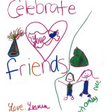

Building Friendships at SCHOOL
(A partnerships between The Arc of Massachusetts and the Massachusetts Department of Developmental Disabilities)
WIDENING THE CIRCLE
Expanding opportunities for friendships between people with and without disabilities
http://thearcofmass.org/programs/widening-the-circle/
Notes:
Welcome participants and introduce your self(selves).

Slide 2

Friends at School
Pathways to Friendship (Widening the Circle) - The Arc of Massachusetts
Notes:
This brief PowerPoint is taken from the toolkit, “Making Friends With & Without Disabilities at School” which is available at no cost on The Arc of MA website (https://thearcofmass.org/friendship). (Click link to show your audience).

Slide 3
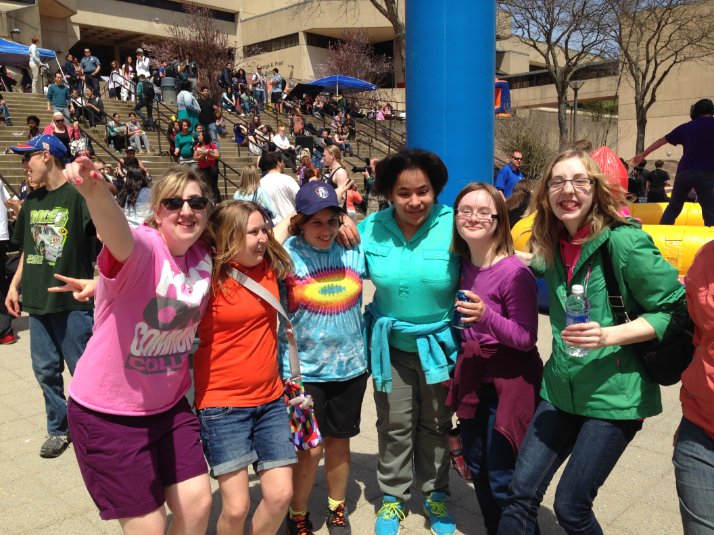
Setting the Stage
Notes:
School is—by definition—a place of learning. It is where most of us learn to read and write and add and subtract. It’s where we first learn about biology and history and foreign languages. It may be the first place where we pick up a baseball or sketch with charcoal or play the trombone or act a part on stage.
School is also where we learn and practice our social skills. How do we relate with teachers? How do we get along in a class with other students our age? How do we know what’s okay to do and what’s not okay? What do we do when we don’t agree with someone? What do we do when we notice someone is “left out”? What do we do if we’re feeling “left out”?
School is where we often first begin the “dance” that can result in friendships. This dance is more difficult for some than for others, including many students with disabilities. It is up to all of us—teachers, paraprofessionals, parents, and fellow students—to be sure that no one is left out. Friendships are too important to be ignored. And friendships between and among students with and without disabilities benefit EVERYONE!

Slide 4
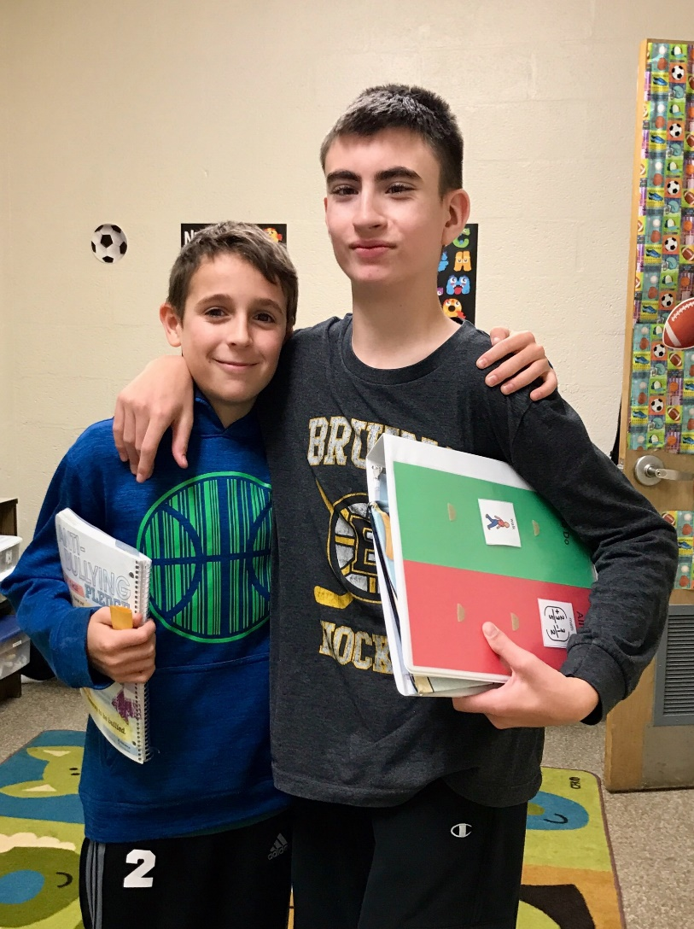
WHY FRIENDS AT SCHOOL ARE IMPORTANT!
Notes:
Friends are important because:
Results in personal benefit. Students and adults alike are happier when they have friends.^{2,3} Having a friend leads to emotional well-being, a sense of belonging, and opportunities for social integration and communication.^{4,5} Students with mutual and reciprocal friendships are more likely to show fewer depressive symptoms and to have greater self-esteem and social adjustment as young adults.^{6,7}
Facilitates developmental gains. Friendship facilitates the acquisition of interpersonal skills and creates opportunities for healthy social, emotional, and cognitive development across childhood and adolescence.⁸ Moreover, friendship provides unique and motivating contexts in which development occurs based on the time and activities students share.⁹
Leads to positive school outcomes. Reciprocal and meaningful peer relationships in adolescence have resulted in greater school engagement.¹⁰ Adolescents with reciprocated friendships report higher levels of school belonging, and both reciprocity and school belonging are related to better academic performance.¹¹
Protects against bullying experiences. Having friends, and especially having supportive friends, can act as a buffer to protect students from negative experiences such as bullying victimization.^{12,13} For middle and high school students with friends, higher levels of perceived support from their friends were related to lower levels of both bullying victimization and perpetration.¹⁴
Enriches individual lives and classroom community. Students with and without disabilities each receive distinct benefits when they develop friendships, including the joy of personal connections, the development of shared experiences and humor, and a greater appreciation for human diversity.¹⁵⁻¹⁷ Students without disabilities may learn new skills (e.g., how to use a communication device) and have their own social-emotional needs fulfilled.^{18,19} Classroom communities may also become more caring and inclusive when friendships between students with and without disabilities are encouraged and supported.²⁰

Slide 5
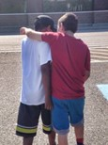
Strategies for Students of All Ages
FIRST develop a friendship mindset!
Increase the QUANTITY of Social Opportunities by:
Maximizing inclusion.
Writing social goals into the IEP.
Building bridges.
Decreasing adult proximity.
Being a facilitator.
Notes:
The first strategy: Develop a friendship mindset. As the first and foundational strategy for this Toolkit, we suggest that teachers and paraprofessionals (and parents) develop a “Friendship Mindset.” This means thinking constantly about the quantity and quality of your students’ social interaction opportunities. Pay close attention to how students with and without disabilities are interacting together. Consider the social implications of your academic decisions (e.g., type of instruction and grouping, adult proximity to students with disabilities). Strive to support students with disabilities to do all that their classmates do during each and every school day. And most importantly, believe that the student with a disability not only can develop and maintain an authentic friendship, but would make a wonderful friend.
Be a facilitator. With a friendship mindset, teachers and paraprofessionals can facilitate social interactions between students with and without disabilities throughout the day. First, model how students with and without disabilities can interact.^{48,56,57} Then, do what you can to a) create new social opportunities, and b) take advantage of missed social opportunities⁴¹:
You can create opportunities by strategically grouping (e.g., same table) or scheduling (e.g., same free period) students to be together, prompting students to interact, and redirecting conversations to students with disabilities. For example, if a student asks you about a classmate’s communication device or a particular behavior, direct him or her to ask the student with a disability. You may also consider making a purposeful error that results in a new social opportunity (e.g., “Oops, I forgot crayons. Can you two share?”).
Missed opportunities occur when students with disabilities are not with their classmates during social times of the day. Some examples include traveling in crowded hallways, hanging out during free time in the classroom, eating lunch, and playing at recess. Try to maximize interactions during these social times of the day, especially lunch and recess.

Slide 6
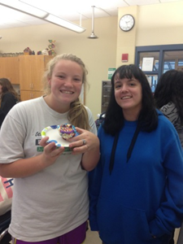
Strategies for Students of All Ages
Improve the QUALITY of Social Opportunities by:
Highlighting students’ similarities.
Interpreting student behaviors.
Teaching students how to interact.
Preparing students for social
interactions.
Conveying student strengths.
Notes:
Strategies to Improve the Quality of Social Opportunities
In addition to increasing social interaction opportunities between students with and without disabilities, it is also critical to focus on improving the quality of social interaction opportunities. Two students may interact frequently, but their social interactions could be one-sided, surface level, focused on help/support only, or otherwise not conducive to friendship development. Higher quality interactions include more than sharing space, being polite, and interacting superficially.³⁴ Our goal is that social interaction opportunities between students with and without disabilities go beyond mere acceptance, greetings, and working together in class to instead be mutual, reciprocal, and based on shared interests and common social experiences across multiple settings over time.^{20,28}
Higher quality interactions are also those that are enjoyable and successful for the students. Sometimes students with and without disabilities may begin to interact, but then encounter a difficulty that stops the interaction. Two types of low quality social opportunities are squandered interactions (i.e., initiation from peer but no response from student with IDD) and stalled interactions (i.e., interactions between students with and without IDD that start off well but then take a turn for the worse).²⁰ We recommend that teachers and paraprofessionals pay attention to these quality components of social interaction opportunities and look to provide individualized intervention in the moment to address these difficulties and improve the quality of students’ social interaction opportunities. Additional strategies to improve the quality of social interaction opportunities include the following:
Convey student strengths. Students tend to befriend others they perceive as being valued in their classroom or school community. Thus, teachers and paraprofessionals should find ways to convey the strengths and capabilities of students with disabilities.⁴⁸ One way to do this is by creating group activities that incorporate students’ strengths (or interests) in the classroom. Such activities resulted in increased quantity and quality of social interaction opportunities without specific intervention in social skills.⁵⁸ Teachers and paraprofessionals may also provide explicit statements or reminders to peers about a student’s strengths.

Slide 7
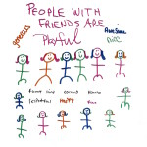
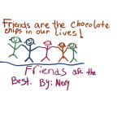
MAKING FRIENDS IN
ELEMENTARY SCHOOL
“I am a friend when… I help people. Also when I play games with my friends. Then I be nice to people. I can also be honest. Friends are amazing.” – 1st grader
Notes:
Friendships in Elementary School
The core components of elementary school friendships are proximity, similarity, companionship, and transcending context.²³ The most important preconditions for children’s friendship are proximity and similarity/familiarity.^{5,62} Then, companionship/mutual activities form the basis for friendships during early school years.¹ Typically, close friends would spend time together in multiple settings. Ultimately, children’s friendships consist of playing and doing things together in multiple settings with similarly-aged peers they see often.
Both the existing literature and our focus groups also indicate a developmental progression of friendship activities and relationships.⁶³ Young children typically all can play together, as students in Pre-K through 1st grade are generally less picky and exclusive. Friendships at this age are mostly behavioral as they primarily consist of repeated instances of playing together. As students enter the middle grades (2nd-4th) they become more aware of social relationships, and their friendships include reciprocal benefits and support. They are generally friendly and happy, though they may become quite concerned with fairness issues. Sports become more important for many children in the middle grades, resulting in hectic schedules and greater difficulty scheduling play dates.

Slide 8
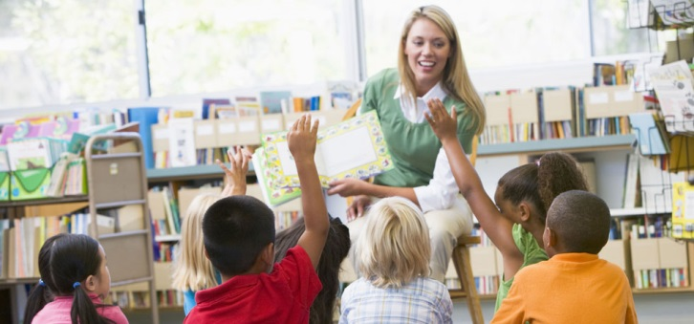
Strategies
Minimize the times that students are pulled out of the classroom.
Monitor interactions to
address classmates acting as adults.
Proactively support inclusive play (for all students) at recess.
Notes:
Minimize the times that students with disabilities are pulled out of the classroom, especially during student activities that are most designed for connecting with each other (e.g., Morning Meeting, Circle Time). When students with disabilities are pulled out of the classroom, their classmates view them as visitors rather than as peers, and thus, less likely as a potential friend.⁶⁶
Be on the lookout for students without disabilities interacting as adults (e.g., as teachers or parents) with classmates with disabilities. It is positive that they want to help, but again, friendship is a horizontal relationship not a vertical one. Remind students that they are not teachers. Show them how they can work and play together as peers.
Recess: Buddy Bench, recess buddies, and/or recess helpers

Slide 9
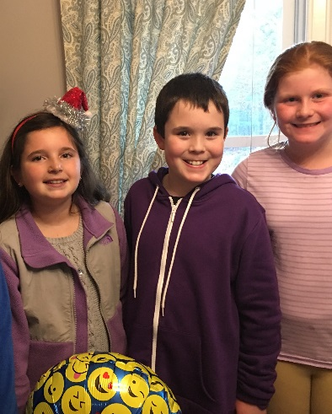
MAKING FRIENDS IN
MIDDLE SCHOOL
“A friend to me is someone who will stick by you.
Someone who will like you for
being you. Someone who will
want to play soccer, basketball,
and maybe catch with me. A
friend is someone that will pick
you up when you are down. They
don’t gossip or talk bad about you. Also, when you
are with a friend you feel free.” – 6th grader
Notes:
Friendships in Middle School
Our focus group participants reinforced findings from much of the literature in clearly stating that social experiences in middle school can be challenging for all students. Students experience a range of physical, social, and emotional changes, and they all respond differently. The common components of middle school social lives are that students’ adult personalities begin to emerge and students turn to their peers more than families.⁶³ Middle school students are entering Selman’s Level 3 (see Table 3) with an awareness of enduring social relationships, thus their social lives are a focus. Early adolescents appear to be similar to their friends in their orientation towards school and their orientation toward contemporary teen culture, which often results in a structure of social cliques.^{1,11} Most students are feeling increased levels of peer pressure, and teasing and bullying may be a concern. Specific to friendships between students with and without disabilities, typically developing students may not want to pair up with students with disabilities as much anymore.
The social context in middle school includes a transition from one teacher and one classroom to multiple teachers and classrooms, often organized in “teams.” While middle school students are more aware of and focused on social relationships than elementary school students, there are fewer social times during their school days. Students will likely have a homeroom and likely will not have recess. Additionally, since students are not yet driving, their social lives are still largely directed by parents and teachers. Many students are probably getting smart phones, thus texting and social media become critical components of their social interactions.
In 5th and 6th grade, sports (and other extracurricular activities) are even more of a focus, resulting in busy schedules. In 7th and 8th grade, students experience the full effects of puberty resulting in a range of responses. Some students still tend toward the relative immaturity of 5th/6th grade while others will try to act older. Some are confident enough to maintain relationships and age-appropriate interactions. In particular, 7th grade can be very variable.

Slide 10
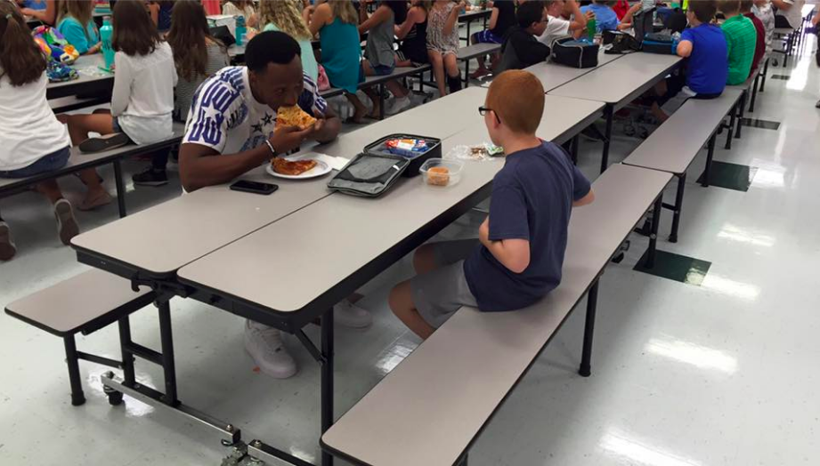
Strategies
Schedule students with and without disabilities “who seem interested” in the same homeroom.
Plan ahead for lunch in
middle school.
Consider supports to be as age- and culturally-appropriate as possible.
Notes:
When possible, schedule students with and without disabilities who attended the same elementary school, seem interested in each other, or share interests in the same homeroom. Multiple focus group participants described success with this strategy.
Plan ahead for lunch in middle school. Be proactive in arranging standing lunch dates with others in the same lunch period. Since it can be stressful and challenging for everyone, students without disabilities may also be looking for classmates to eat with. Note, we are not recommending that you start a “lunch bunch.” Just let students know where others from their team will be sitting in case they want to sit there. … Emphasize and maximize social interaction opportunities between students with and without disabilities during the relatively limited social times of the middle school day.^{41,68} These include before and after classes, during down time in class, in the hallways during passing periods, lunch, home room, elective classes/specials, and dismissal (e.g., waiting for the bus). For example, students with disabilities should attend the same lunch as their peers and sit with them, not the adults who support them. In our focus groups and prior research, we still heard of students with disabilities coming to lunch late and sitting at a table on the side with teachers or paraprofessionals only.
We all want to be appreciated for our unique personalities and qualities. We'd like to think that how we look, how we dress, how we act are not nearly as important as what we're like inside. But making friends, especially for middle school students, often requires "fitting in." And to fit in, students with disabilities may need to be supported to be as age- and culturally-appropriate as possible without stifling their sense of self. That means:
Dressing in ways acceptable to the times
Fashionable hair styles may be important.
Appropriate make-up
Having a cell phone

Slide 11
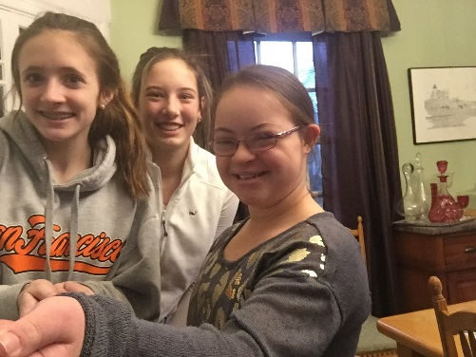
MAKING FRIENDS IN
HIGH SCHOOL
“I wanted to be friends with Sara (a classmate with
Down syndrome) because
she was always so fun and
energetic in the mornings.
She was always dancing in
hallways. When I told my
parents they thought it was
nice, but then they
realized it wasn’t just me being nice. Sara was really
fun and we were really friends.” – 9th grader
Notes:
Friendships in High School
High school brings several new difficulties to the challenge of friendships between students with and without disabilities. One of the critical barriers to address is that there is typically much less inclusion and much more focus on academics in high school than there was in elementary school and even in middle school. This means that there is much less shared time between potential friends compared to the earlier grades. The high school is typically much larger than the middle school, often with students from multiple feeder middle schools. This also means that a large percentage of the student body will not know some of the students with disabilities and may not be familiar with inclusion. Finally, social lives in high school are now student-directed as many students will have obtained their licenses and will be driving. Unfortunately, their vehicles are likely not going to be accessible to students who use wheelchairs or have other disability-related needs. Sports and other activities may be prominent for many students, thus they will have very busy schedules after school.
However, high school also brings new advantages for friendship development. Many high school students will be more confident in who they are, less susceptible to peer pressure, and less likely to engage in bullying experiences. Moreover, some typically developing peers may be more open to friendships with students with disabilities in high school.^{17,41} Thus, there is great potential for increased quantity and improved quality of social interaction opportunities. High school students are largely engaging in mature relationships reflective of Selman’s Levels 3 and 4 (see Table 4). Students in 9th and 10th grade may still engage in some middle school behaviors and perspectives, but most 10th-12th graders will have friendships and social interactions that are reflective of those between young adults. Most students will have smartphones, thus their social lives include and are often coordinated by lots of texting and social media use. Finally, transitioning to high school from middle school and transitioning from high school into adulthood can be stressful times for all students, but they also represent significant opportunities for students with and without disabilities to interact socially and support each other. Existing relationships from middle school can provide support systems and be strengthened in high school. Students may be more likely to join clubs and eat lunch together when they feel that they do not know as many of their peers in high school.

Slide 12
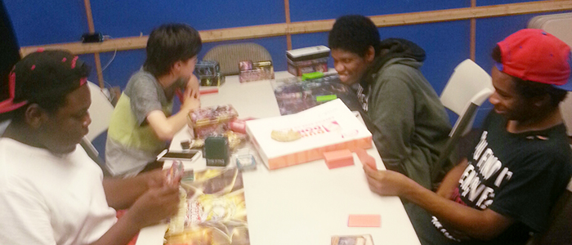
Strategies
Support students with disabilities to travel to and from school as their peers do.
Support students with
disabilities to join
interest-based clubs/
activities and attend them without adults.
Teach classmates/peers how to engage in “friendship work.”
Notes:
One of the situations that results in perceiving students with disabilities as "different" is when they are transported to school differently than their typically developing peers. Thus, try to figure out supports and systems so students with disabilities can take the regular transportation just like everyone else. Transportation is a related service under IDEA, and bus monitors and other staff should be part of a student’s IEP as appropriate. … Figure out the transportation and accessibility needs of students with disabilities. Since many high school students are driving their own vehicles, friendship supports may include problem-solving to allow students with disabilities to ride with their peers to and from school, a sporting event, or play practice.
If the high school has a Diversity Club, ensure that it includes disability as part of diversity and has students with disabilities in the club! In fact, there are many positive social opportunities when a special education teacher becomes faculty advisor to such a club.⁴¹ If the high school does not have a Diversity Club, start one. … High school students with disabilities should join interest-based clubs and extracurricular activities, and they should attend them with classmates (not adults) whenever possible. There are many ways to be involved in the activity you like, though you may need to be creative. There is no need to create “special” activities or clubs.
Teach peers how to engage in “friendship work”.⁶⁰ Because some students with disabilities may struggle to initiate and/or engage in social interactions, their peers without disabilities may need to provide various supports in order for them to spend time together socially. Some examples of friendship work include initiating conversations or activities together, providing necessary prompts in the moment (e.g., a calming touch on the shoulder or a verbal reminder to tell the waiter what they want for dinner), and waiting for responses from students with disabilities (i.e., being patient). Another example from some focus group participants was asking their friend with Down syndrome, “Is that what you wanted to happen or what actually happened?” when she told a story that may or may not have actually happened in efforts to fit in.

Slide 13
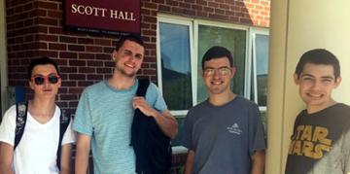
MAKING FRIENDS IN
COLLEGE
"I feel I've grown a lot as a person since I've been living on the BSU campus. Not only have I gotten to know many new people, this has also been a great opportunity to further my independence.” –College student
Inclusive Concurrent Enrollment (MAICEI) / Strategic Initiatives / Massachusetts Department of Higher Education
Notes:
There are increasing opportunities for students with intellectual and developmental disabilities to pursue post-secondary education. For instance:
The state-funded Massachusetts Inclusive Concurrent Enrollment Initiative (MAICEI) funds partnerships between local school districts and two- and four-year public colleges and universities in Massachusetts. The term “Concurrent Enrollment” means that participating students are still eligible for special education services, even though they have finished four years of high school. Students in MAICEI programs are enrolled in college while at the same time receiving special education services through the school district providing that support.
Students participating in MAICEI are fully included in the campus community as they develop their capacities in career-planning and employment, self-advocacy, and other self-determined abilities that support their post-secondary interests and activities. For example, students participate in:
College or university courses that support their goals
Social activities on campus, including student organizations and other extracurricular activities of interest to the student
Person-centered planning
Paid work and internships
Independent living and independent travel
Evidence shows that students benefit academically and transition to young adulthood more readily when they can engage in the array of academic, social, career development, and individual self-development activities that are typical for all college students on a campus, rather than staying at high school. Students participating in MAICEI quickly establish new social networks, participate in campus-wide events, learn to use public transportation to and from campus, acquire academic knowledge and skills, and build strategies to find fulfilling work. Most important, MAICEI students grow into more independent decision-makers who are better equipped to define their own personal and career goals and determine how to achieve them. Not only have MAICEI programs proven to be important learning experiences for students, they have also supported the development of more inclusive college and university communities. They have also strengthened more person-centered policies and practices for everyone involved in the transition experience, including students, family members, and school personnel.
Student participation in this grant program may be incorporated into a student’s transition program, as determined through the school district’s special education process.

Slide 14
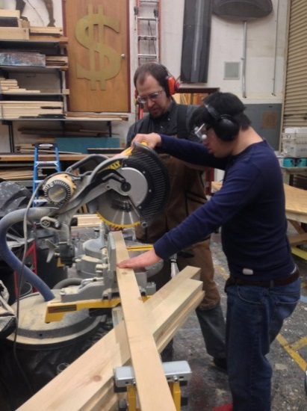
FINAL THOUGHTS
Notes:
Despite widespread awareness of the importance of friendship, students with and without disabilities still infrequently develop friendships, even in inclusive settings.
We feel strongly that all students can and should develop friendships, including those students with the most significant support needs. Even while students may be working on specific social interaction skills, teachers (and families) can create contexts in which students experience a greater quantity and higher quality of social interaction opportunities. Teachers can systematically enact purposeful and individualized strategies to address this challenge of friendship.
As you’ve seen, there are many strategies to promote friendships between students with and without disabilities. The strategies emphasize maximizing social opportunities that can lead to the development of friendships. Ultimately, we want students with and without disabilities to share motivating and authentic experiences together because friendships are more likely to develop when students get to know each other and enjoy their time together.
Because it is not realistic to expect to solve this challenge immediately, we recommend that teachers and parents start by considering the ways they may adopt the “friendship mindset.” Then, choose one strategy to increase the quantity of social interaction opportunities and one strategy to improve the quality of social interaction opportunities.
Let’s all work together to move from social acceptance and daily greetings to meaningful interactions and authentic friendships for students with and without disabilities.

Slide 15
Resources
Dr. Zachary Rossetti, Boston University,
zsr@bu.edu
Jim Ross, Co-Coordinator, Widening the Circle, jbriii@comcast.net
Widening the Circle, Pathways to Friendship (Widening the Circle) - The Arc of Massachusetts

